Slide 1
NPC

Slide 2
NPC Architecture
Layered Architecture View

Slide 3
NPC Deployment Architecture
Mode of deployment – SM and ME

Slide 4

NPC geo-redundancy
1+1 mated pair
SM sites are Active-Standby (hot)
Service definition: SM has master copy & distributes to sites
SM selects device home or is instructed by OSS
SM maintains the device home location & each ME does geo-replication
REST SOAP
SM1
Geo-replication
SM2
OSS
ME sites are Active-Active – No idle hardware
NPC Site #1
NPC Site #2
NPC Site #3
NPC Site #4
NPC Site #5
NPC Site #6
ME
ME
ME
ME
ME
ME
Geo-replication
Geo-replication
Geo-replication
Region 1
Region 2
Region 3
Multi-node support increases deployment flexibility for large operators by dividing into regions and supporting a combination of Policy and Charging nodes
Notes:
reliability

Slide 5
NPC SM & ME systems configured with all modules
5G, Diameter peers
Operation and Management, logging
Provisioning, API requests, SPR traffic
Operation and Management, logging
Provisioning,
API requests,
SPR traffic
Provisioning, API requests
Notifications,
IT system interaction
API to SPSs, IPv6 to ME
IOH
Core
IOH
API
IOH
OAME
OAME
CDR
SM App
Apps
ComSvcs
AUX*
AUX*
DB
DB
NPC SM System
NPC ME System
DB replication
Legend for VM engineering:
DB replication
SU VM groups shown as gold, blue, and green boxes
* Aux VMs host Service Discovery and Configuration (SDC) and always use exactly 5 VMs
1 + 1
N + K
2*(N + K)

Slide 6
NPC VNF lifecycle management
Via Nokia CBAM VNFM
Create
Modify
Instantiate
Heal, auto-Heal
Backup, restore
Disaster recovery
Terminate
Delete
Scale out/in, auto-scale
Upgrade
Life Cycle Events
Instantiate VNF
Healing
Scale out /Scale –In
Terminate VNF
Delete VNF
Backup and Restore
VNF Network Upgrade
VNF Disaster recovery
Auto Healing
Auto Scaling

Slide 7
Agenda
Product overview & main benefits
Product functionalities
Interfaces & integration capabilities
Policy Rules
Main use cases
Q&A session

Slide 8
Policy Management
Sample policy behaviors
NPC can provide the following to gateways
QoS, including rates (down/up) and priority
PCC rules to define gateway behavior for a session/flow
Redirects
Charging related policies (such which rating group to use)
NPC can accept or reject/terminate sessions
It can register for events from the gateways
Be notified when events occur, such as a RAT Type change
Usage monitoring, such as reporting when a UE has used 20MB of data
Policies are provided on request and can be pushed for updates

Slide 9
Policy Management
Policy control
NPC provides the Policy and Charging Rules Function (PCRF) in 4G/LTE
It provides policy to gateways (PCEFs)
NPC provides the Policy Control Function (PCF) in 5G
Both can be provided in the same NPC instance – a combined PCRF+PCF
NPC can provide policy based on a wide variety of inputs, including
Subscription type
Type of device
Location (such as MCC/MNC, GGSN IP address, cell tower)
Configured subscriber/device data
Time of day / day of week
Usage related policies, such as CHF/OCS counter values

Slide 10







Policy Management
Networks need policy management
OSS/BSS
SPR
AF/IMS
Provides policy to network elements to enable subscriber experience
Ud LDAP
IMS
REST
Rx
NPC can use NCC or a third-party OCS.
Sy
NPC
OCS
PCRF
Charging
GERAN
Gx
MME
Sd
RNC
SGSN/SGw
GGSN/PGw
DPI
CDN/ Video Opt.

Slide 11
NPC
Ease the migration to 5G
NPC will provide policy for both 4G/LTE (a PCRF) and 5G (a PCF)
Provides a single consistent view of a subscriber / device
Manage policies across both 4G and 5G
Use common rules/information where appropriate, or 4G/5G specific rules when needed
Migrate subscribers more easily from the 4G network to the 5G network
GGSN/PGw
SGSN/SGw
Gx
Rx
Sy
AF/IMS
PCRF
OCS
4G
AF
PCF
CHF
5G
N5
N28
N7
N15
UPF
SMF
AMF
RAN

Slide 12
Agenda
Product overview & main benefits
NPC Architecture
Interfaces & integration capabilities
Policy Rules
Main use cases
Q&A session

Slide 13
Policy Management
Rules-based flexibility
New rules editor
Variables
Mappings
Scripting editor rather than clicking forms
Cut & paste rule code
Autocomplete and syntax checking
Decouple independent rule logic that can be called as variable in main Business Rules
Can use Mappings for further simplification
Each mapping can have multiple keys and outputs
Used enter long list such as MCC/MNC location, cell tower lists, plans/OCS counter states, QoS related attributes, etc.
The core of the rules engine is carried forward from the DSC

Slide 14


Policy rules: Why use a rules engine and what does it do?
Provides highly flexible and efficient policy definition
Rules are evaluated when an event occurs
Rules are only used when a custom policy is needed
When defining policy, or authoring rules, many inputs can be used to determine the policy
An easy and controlled way to move rules from the lab to production
OCS/CHF
Nokia Policy Controller
Other influencing events
Subscriber DB
Gateway/TDF
Network
OCS=Online charging system CHF=5G Charging function

Slide 15
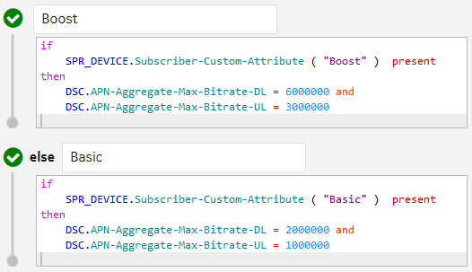
NPC Rules
Writing rules
Rules are edited in the GUI using a simple IF (condition) THEN (action) format
They are entered as text with autocompletion and syntax checking

Slide 16
Agenda
Product overview & main benefits
Product functionalities
Interfaces & integration capabilities
Policy Rules
Main use cases
Q&A session

Slide 17

Policy Management
To each their own…
Device type based policy (type/model)
RAT based policies
Notifications (email, SMS, web service)
Location based
(roaming, in region, home)
Use lookup tables (custom data)
Time of day, day of week policies

Slide 18
Sample use cases
Location based
A variety of location information is available to determine policy
MCC / MNC indicates which network a device is on
Can be used for roaming scenarios
Cell tower Ids can be used for fine-tuned location information
Such as policy at a subscriber's home location
Or in/around metro/subway stations
The gateway IP address can be used
Sometimes used if MCC / MNC are not sufficient

Slide 19
Sample use cases
Many possibilities…
Similar to the examples shown, rules can be tailored in many ways, including
Policy based on the DNN/APN – different privileges for different DNNs/APNs
Policy based on the slice (5G)
User equipment type based policy
Access type dependent policy (such as by RAT-Type)
Policy may push PCC rules to the gateway
Can enable redirects of flow-based handling of traffic
The policy rules can send notifications to the subscriber
By email, SMS or web service call
OSS/BSS facing APIs allow for self-care
Subscribers can be provided a portal to configure policies

Slide 20
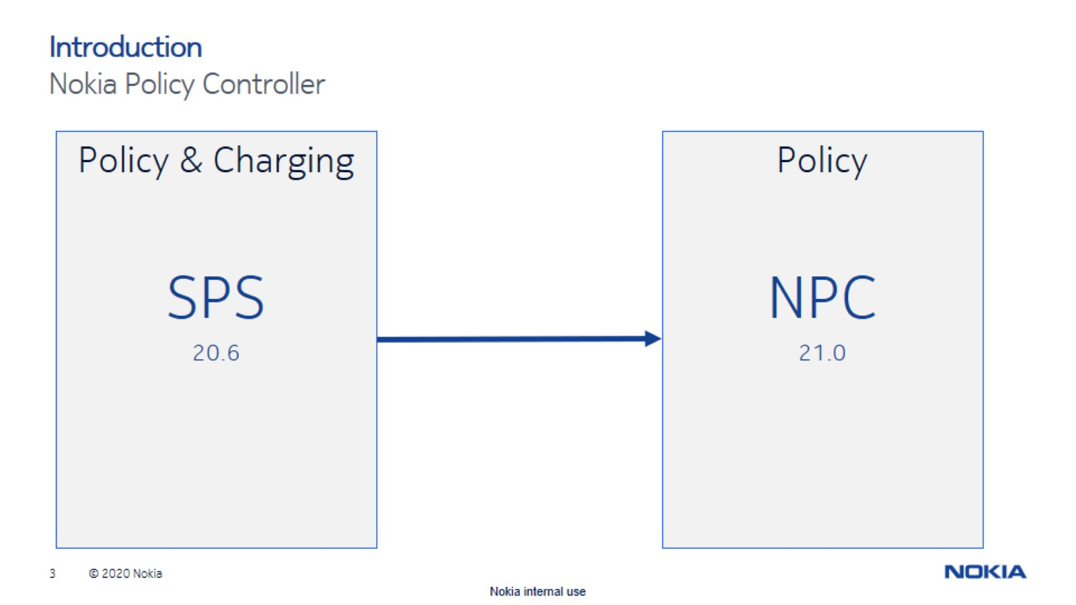

Slide 21
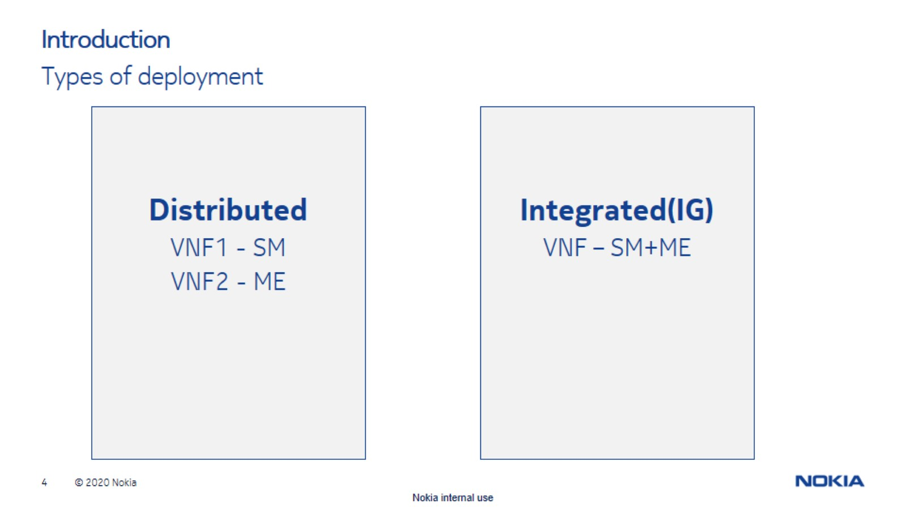

Slide 22


Slide 23
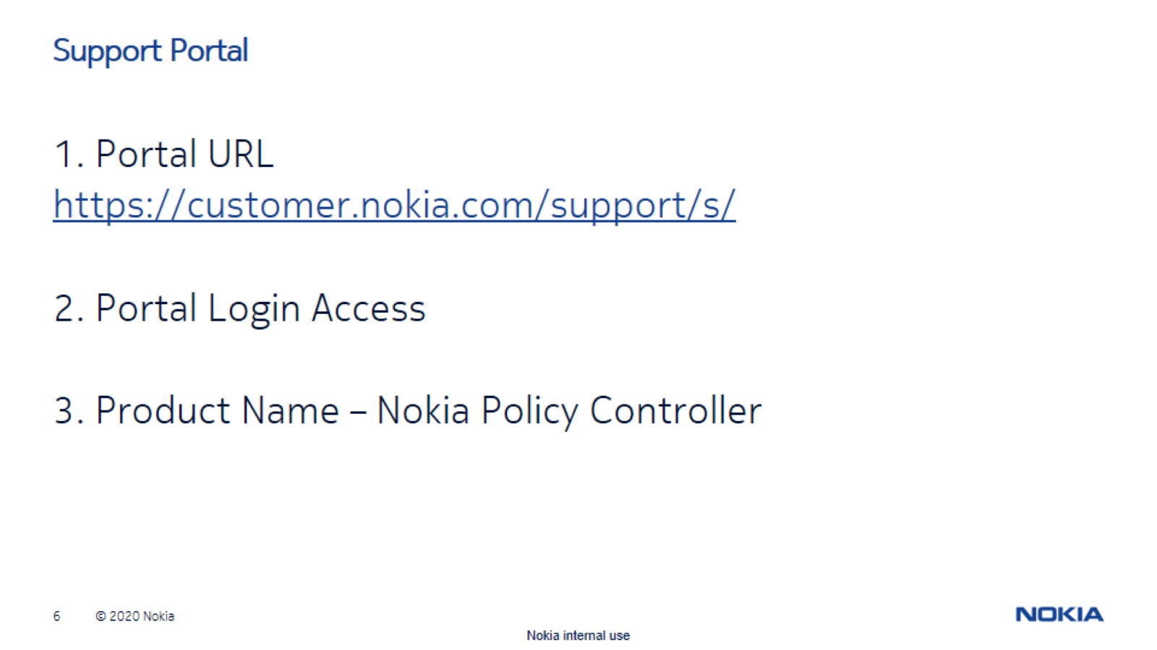

Slide 24


Slide 25
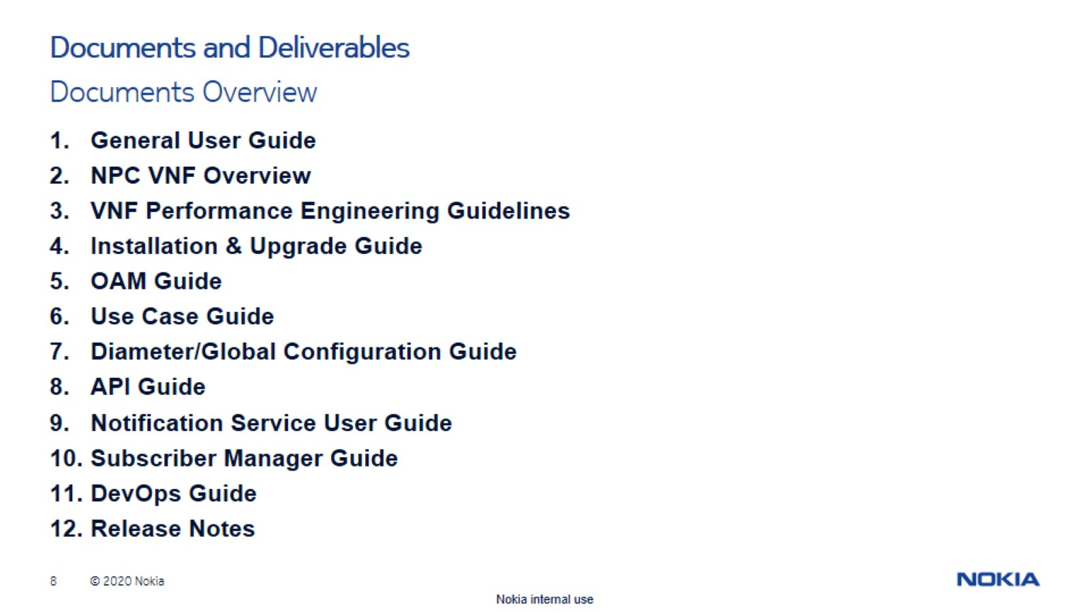

Slide 26
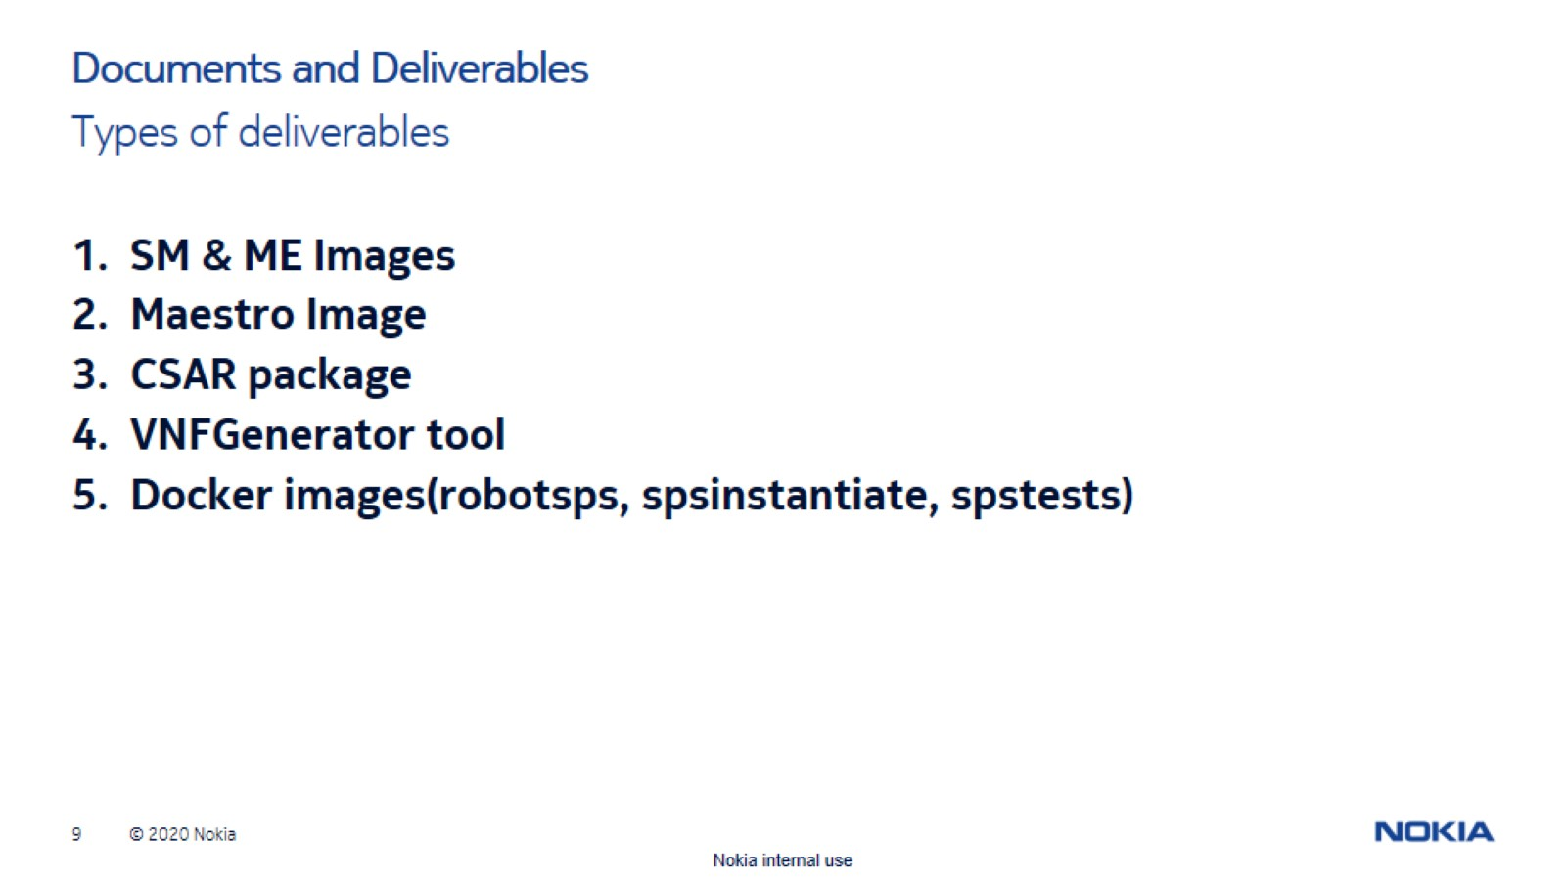

Slide 27
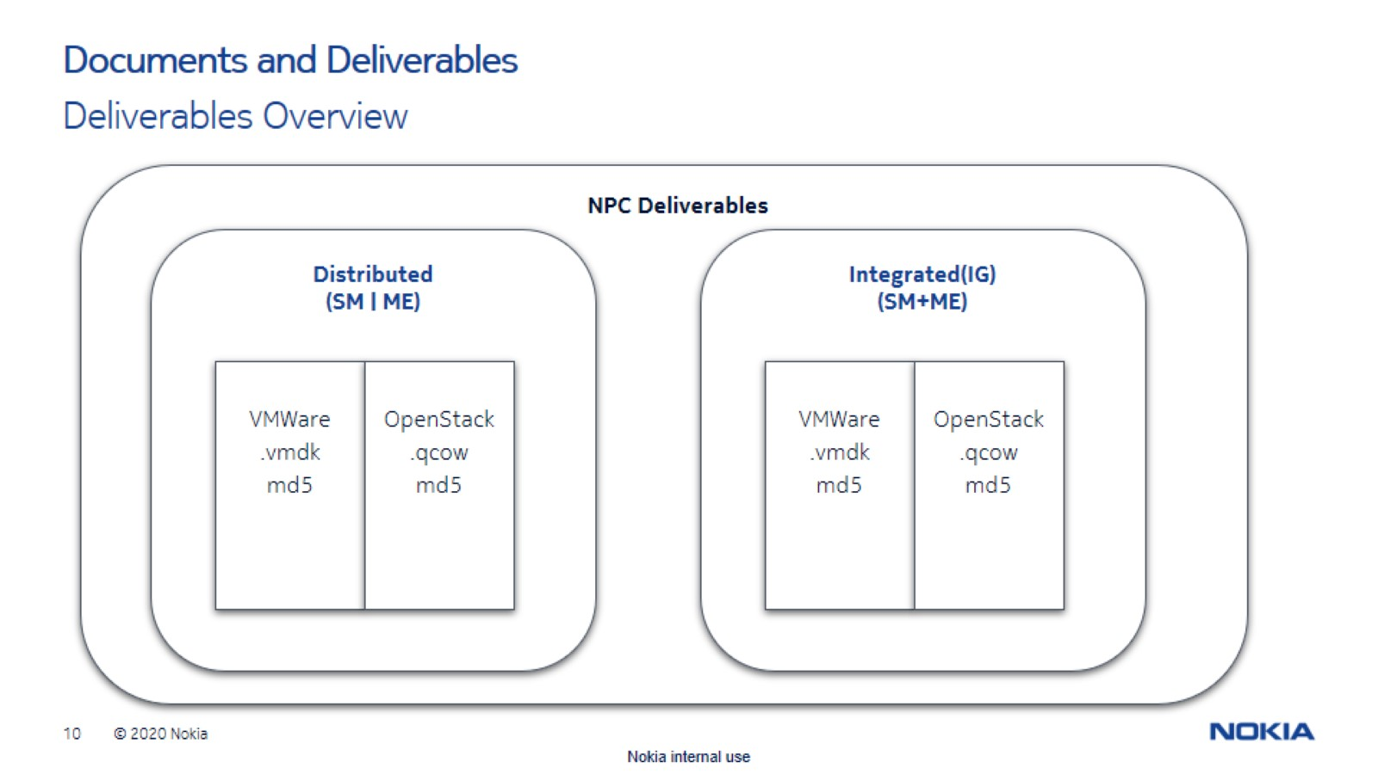

Slide 28


Slide 29
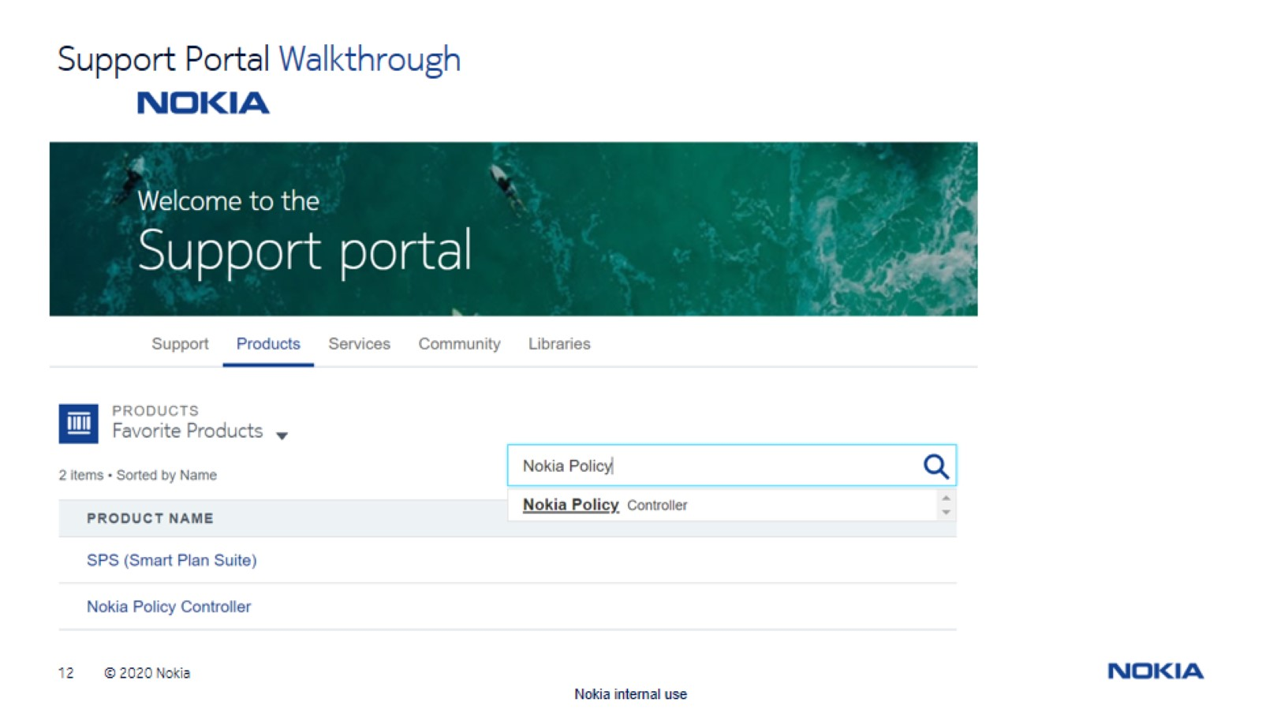

Slide 30
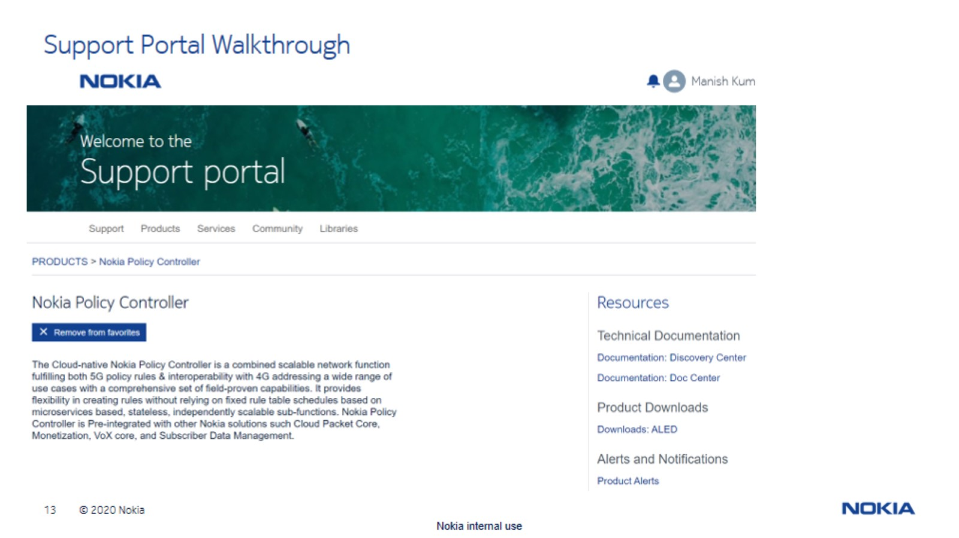

Slide 31
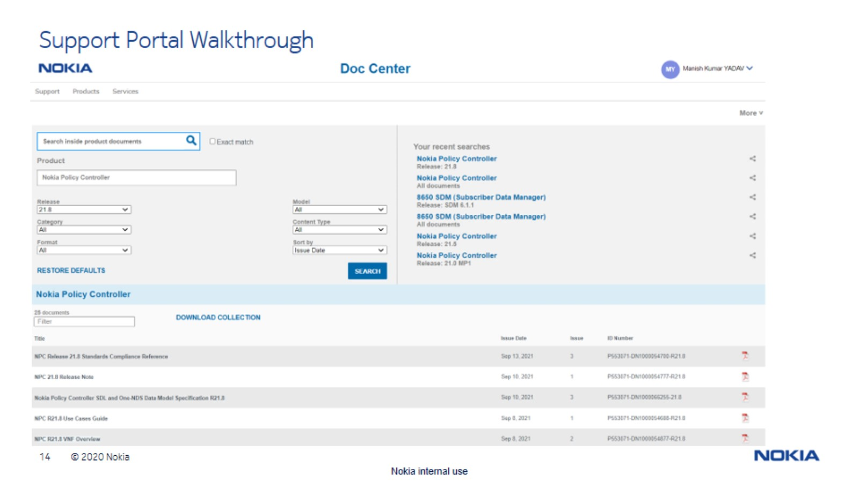

Slide 32
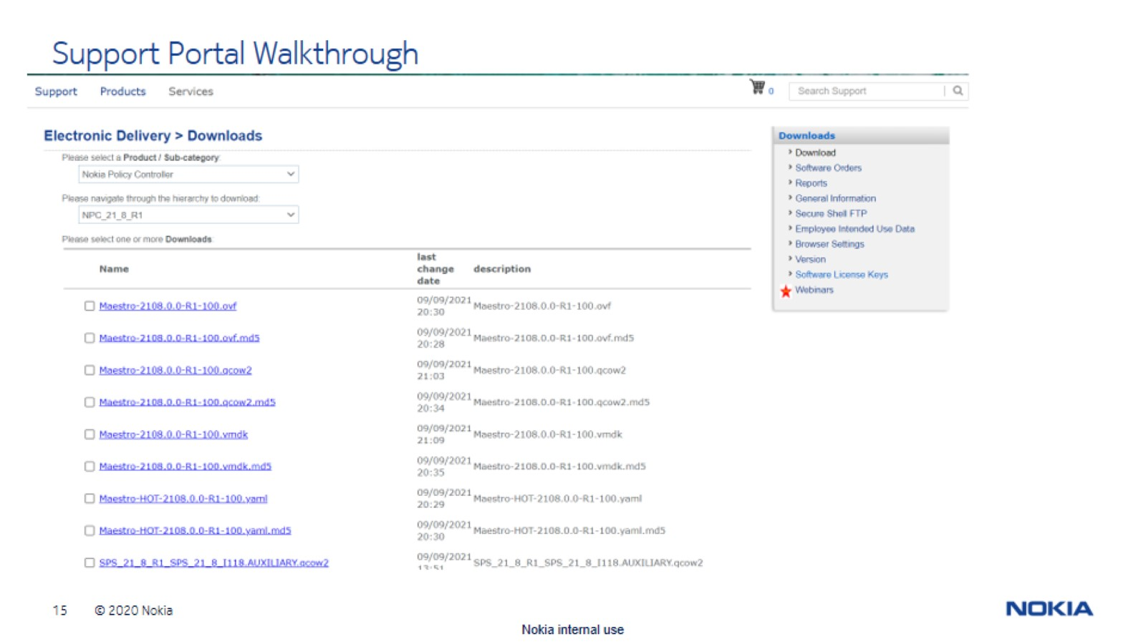

Slide 33
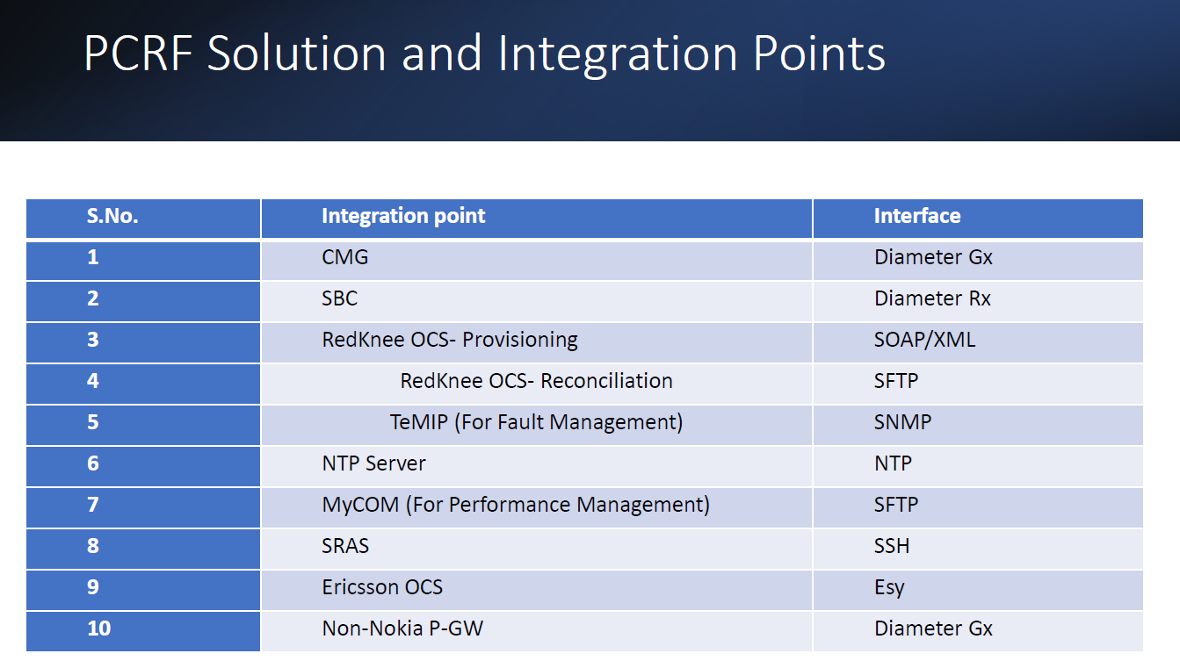

Slide 34
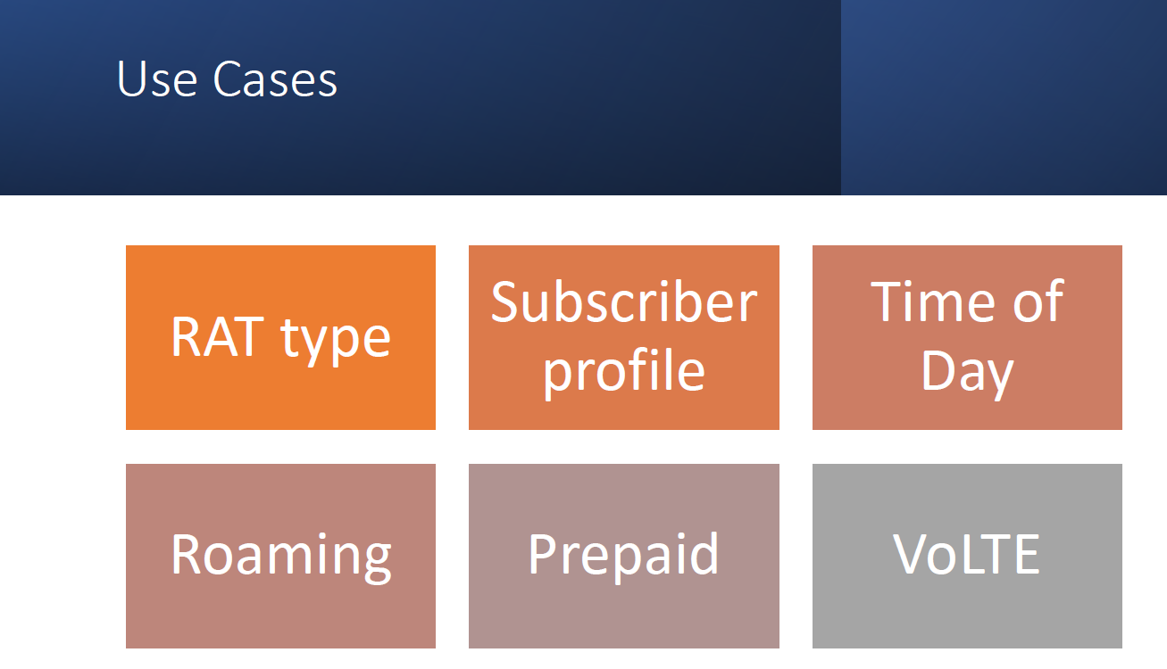

Slide 35
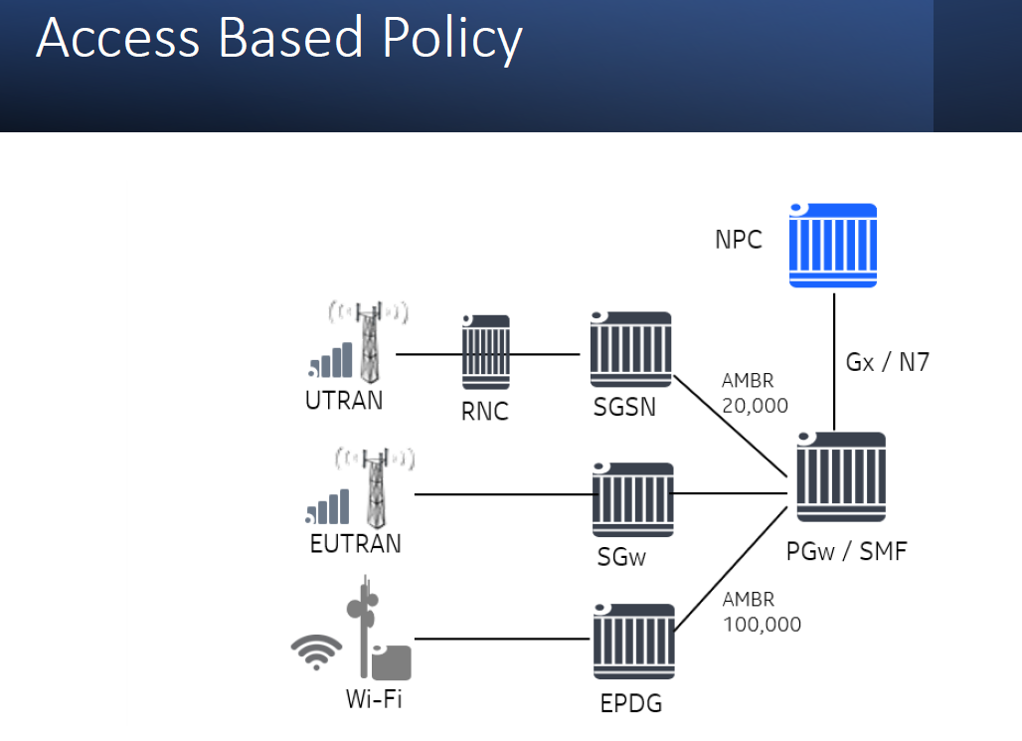

Slide 36
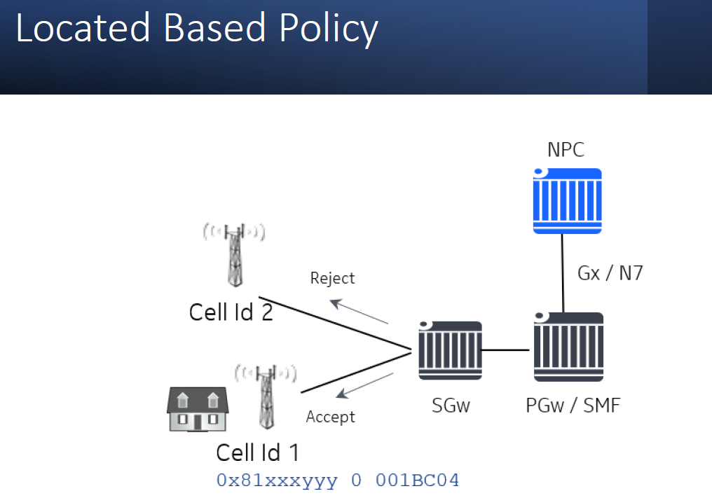

Slide 37
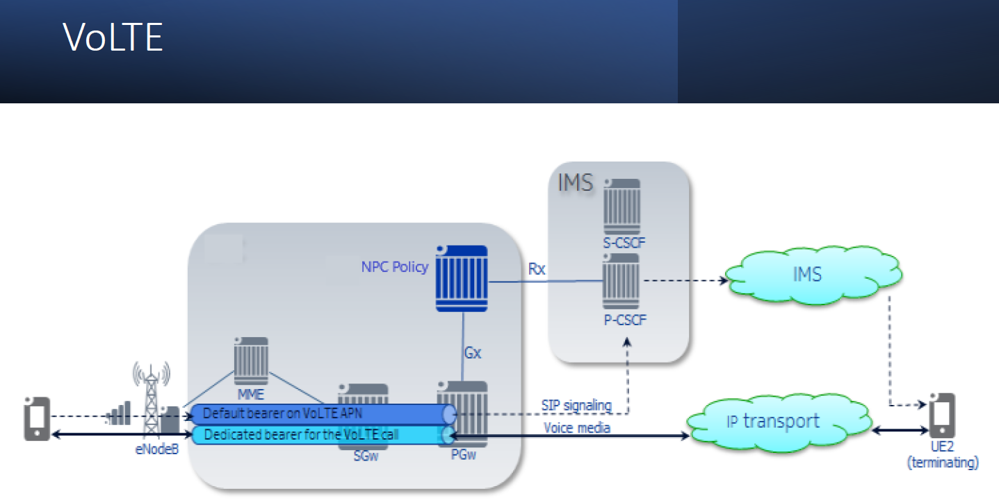

Slide 38
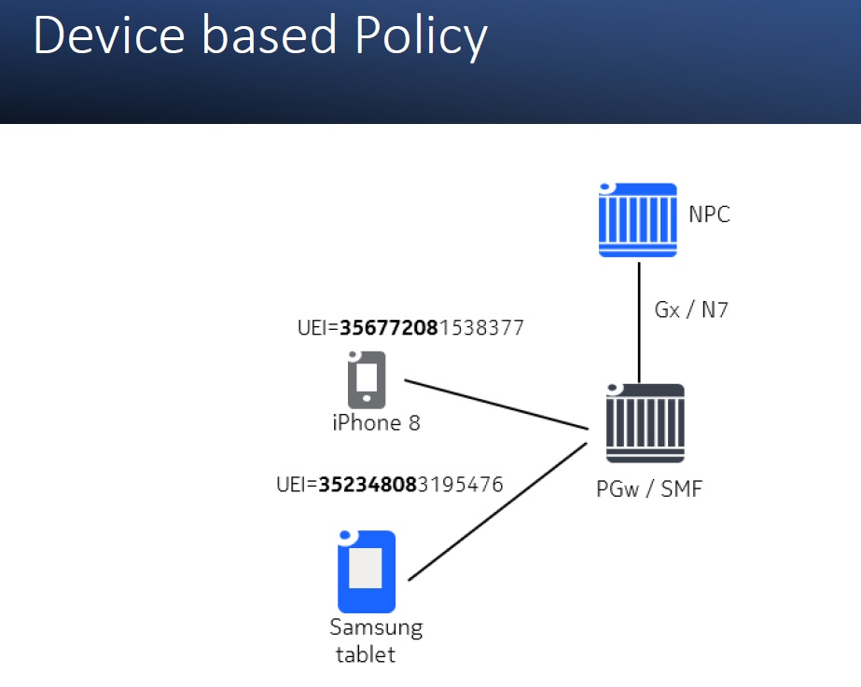

Slide 39
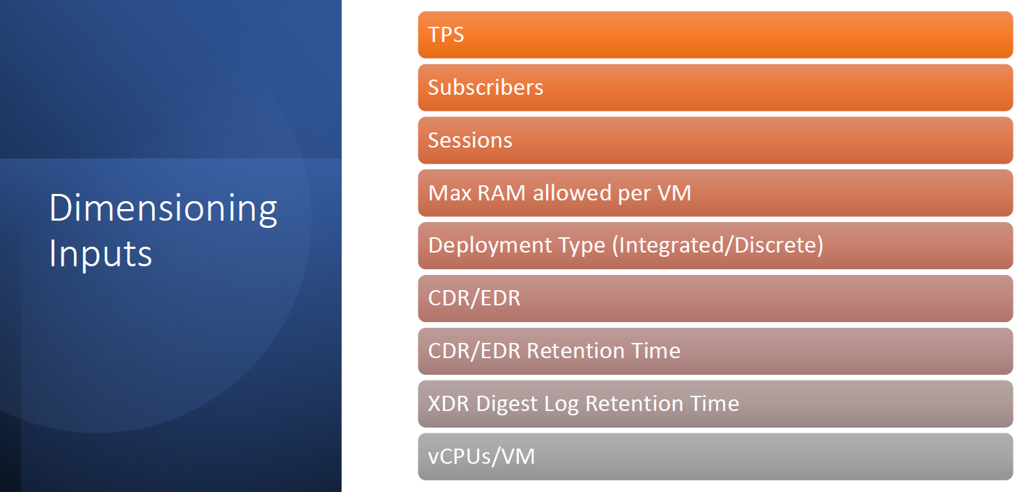

Slide 40
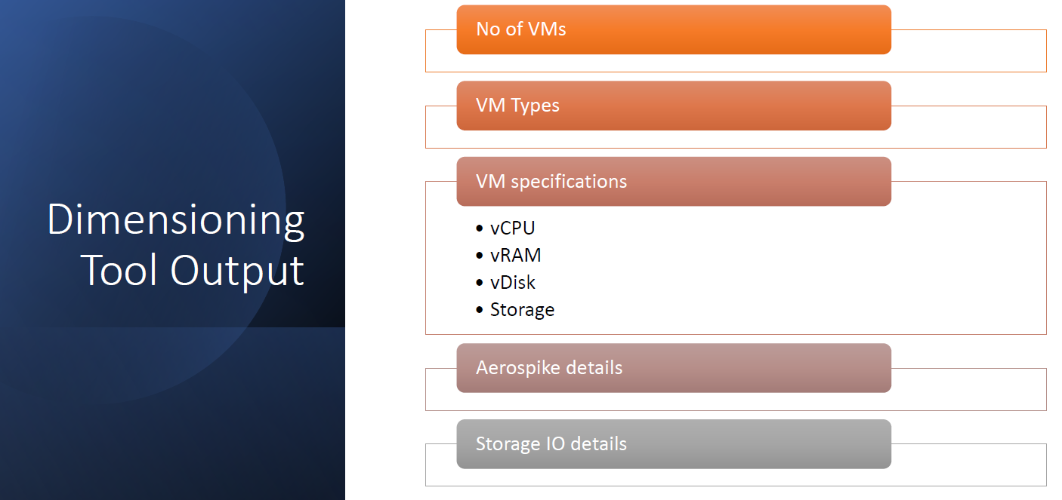

Slide 41
Introduction to Deployment
Distributed SM
Distributed ME
Integrated SM+ME

Slide 42
Images download source
Maestro Images
https://repo3.cci.nokia.net/sps-generic-candidates/DevOps_images/
VNF Images
https://repo.lab.pl.alcatel-lucent.com/sps-generic-candidates/spsmainbuild/SPS_22_0_I24/

Slide 43
Planning the allocation of external IP addresses to the VNF VMs
Internal IP
The IPs allocate to internal network
External IP
The IPs allocate to external network
Subnet
Internal 192.168.3.10/24
External 10.68.125.70/24

Slide 44
Agenda
Product overview
Introduction to Deployment
Deploying maestro VM
VNF generator tool
SM /ME Deployment

Slide 45
Deploying maestro VM
Download maestro VM image and hot yaml file to UC node
Configure heat yaml file.
Deploy maestro VM as a heat stack

Slide 46
Starting VNF generator tool on maestro VM
Download VNF generator tool to maestro VM
Download csar package to maestro VM
Create and prepare vnf generator workspace
Starting vnf editor inside sps instantiation docker
Using vnc client to reach vnf generator graphical too

Slide 47
Deployment
Installation Guide/Release Notes to be downloaded from NOLS - Link
Sample JSON file
Health Check-up
Check the status of services

Slide 48
Documentation Navigation
VNF Overview
Link
VNF Installation and Upgrade Guide
Link
VNF Operation Administration and Maintenance Guide
Link
Policy User Guide
Link
Training Session
Link

Slide 49
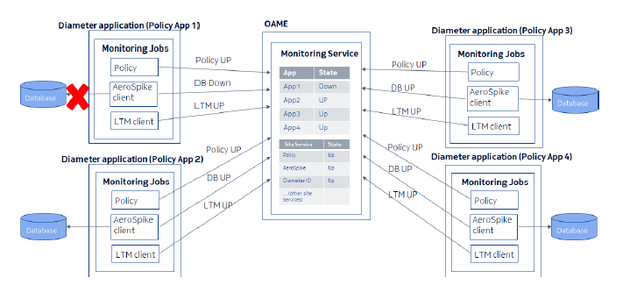
Nokia Policy Controller
System Health & Health Checks
The system health is a resultant value derived from the health of constituent components.
The system must be monitored for degradation of health (systems not working at rated performance, or not working at all) and troubleshooting activities should be performed as needed.
Health monitoring is composed of several checks that are run on several component systems. Few to list are as below
Disk usage
HA to ensure active-standby operation
Reduced availability for N+K local redundancy. Loss of more than K systems results in an outage
All services monitoring running on NPC SM and ME VMs.
To check sps basic health of VMs and its services ‘sps-status’ command can be used and executed using tpaadmin user on the OAME node (preferred).
Monitor status of different services like aerospike, LTM, kafka, traffic to nodes on IOHD etc which are down and performing actions to restore them.

Slide 50
Nokia Policy Controller
System Health & Health Checks (contd..)
Several services are monitored by NPC. Key services are listed under -
Aerospike Cluster Service, XDR Service
CDR Service
Charging application Service
CKEY Service
CMDB Service
DiameterIO Service
ETCD Cluster Service
httpIO Service, SMAPP Service
KAFKA Service, TEM Service, TRSCHEDULER Service
Loadbalancer Service, LTM Service, Notification Service, Policy app Service, Provisioning Service, Rollback Service

Slide 51
Agenda
System Health & Health Checks
NPC Alarms
NPC Measurement Collection
Measurements in Prometheus & Grafana
Sample Screenshots
Q&A

Slide 52
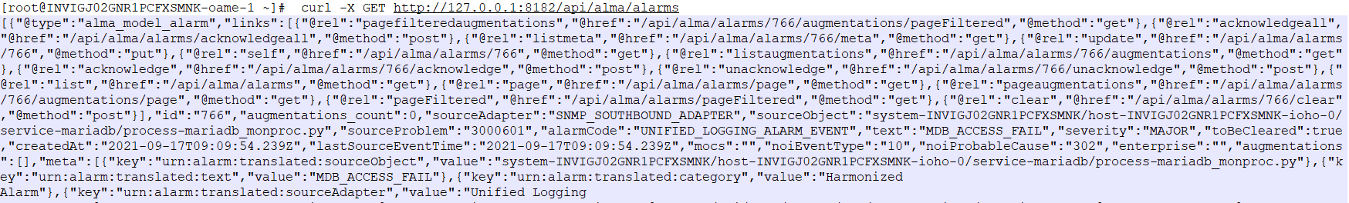
Nokia Policy Controller
NPC Alarms
Alarms are generated to alert operators of abnormal behavior. Alarms are raised by the Policy, Charging, and Service Manager (SM) applications as well as by the system and Operation Administration Maintenance Endpoint (OAME).
These alarms are meant to be sent to the Environmental Management System (EMS) that displays them.
The alarming service is provided across a cluster of machines in a cloud environment and supports the following:
southbound interface that allows applications to generate alarms
alarm management that includes alarm processing, storage and lifecycle management
northbound interface (SNMP v2c/v3) that reports alarms to the EMS.
Active alarms are stored in the ETCD backend. To see active alarms, run the following command on the Active OAME VM:
curl http://localhost:8182/api/alma/alarms

Slide 53
Agenda
System Health & Health Checks
NPC Alarms
NPC Measurement Collection
Measurements in Prometheus & Grafana
Sample Screenshots
Q&A

Slide 54
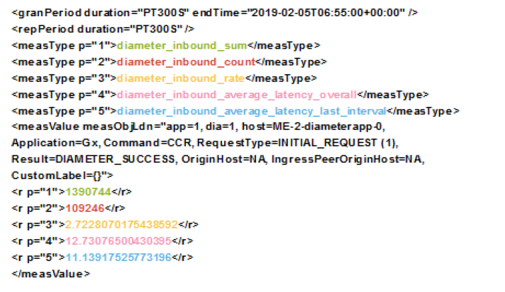
Nokia Policy Controller
NPC Measurement Collection
NPC collects a broad range of measurements to provide a rich set of data for understanding the load and behavior of the system and its network integration.
The metrics are available to examine on the NPC itself and can also be retrieved by external systems for offboard analysis.
Metrics are gathered onto the central OAME nodes in each NPC, where the Prometheus server and database are located.
Both OAME nodes run the Prometheus server and both actively collect measurement data from the clients and store the data in their own local databases, such that all measurements data continues to be available following an OAME switchover.
A Prometheus client runs on all the nodes that are recording metrics to be collected by the Prometheus server on the OAME.
Measurement collection config GEN3GPPXML file format as shown in figure to the right.

Slide 55
Nokia Policy Controller
NPC Measurement Collection (contd..)
NPC has two modes of measurement collection: CSV and PROMETHEUS
When the measurement mode is CSV then NPC generates the metrics data in CSV format on the OAME nodes under /appdata directory. These files can be further pulled by respective integrating monitoring agent NE.
When the measurement mode is PROMETHEUS then NPC generates the metrics data in XML format on the OAME nodes under /appdata/meas directory. These files can be further pulled by respective integrating monitoring agent NE.
The tool for configuring metrics mode is located under /opt/tpa/bin directory. After execution, for a change to take place, we need to restart the application on all the VM nodes.
configure-metrics-mode -m <METRICS_MODE>
Where <METRICS_MODE> can be either ‘csv’ or ‘Prometheus’.

Slide 56
Agenda
System Health & Health Checks
NPC Alarms
NPC Measurement Collection
Measurements in Prometheus & Grafana
Sample Screenshots
Q&A

Slide 57
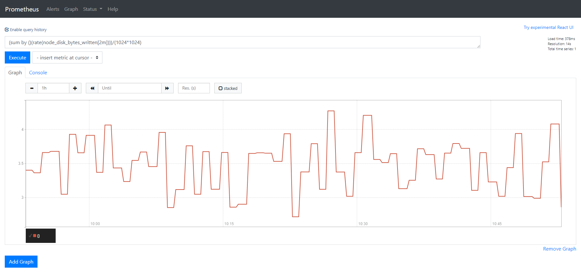
Nokia Policy Controller
Measurements in Prometheus & Grafana
Prometheus provides a multi-dimensional data model with time series
data identified by metric name and key/value pairs.
It is a free software application used for event monitoring and alerting.
A flexible query language is supported for retrieving data from the
database. It uses an HTTP pull model with real time alerting. It is licensed
under Apache 2 License
Prometheus GUI queries should be executed on OAME standby node.
Prometheus GUI can be accessed at:
http://<OAM IP>:9090
A sample snap of the Prometheus GUI is shown in the figure to the right

Slide 58
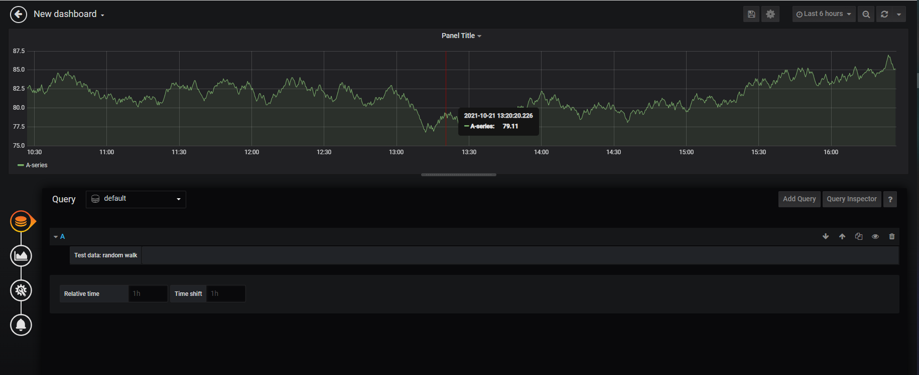
Nokia Policy Controller
Measurements in Prometheus & Grafana (contd..)
Grafana is a multi platform open source analytics and interactive visualization web application which provides charts, graphs and alerts for the web when connected to supported data sources.
Grafana keys are configured in vnf extensions json file during the time of deployment. In a standard deployment the default values are used as it is.
The Grafana admin user must create users on the dashboard to access specific graphs/metrics.
Each instance of Grafana software works independently on each OAME and must be configured on both OAME nodes i.e. active and standby.
Grafana GUI can be accessed at:
https://<OAM IP>:8003
Default first time admin login credentials ‘admin/admin’ can be used.
Sample dashboard view is as shown in the snapshot to the right.

Slide 59
Agenda
System Health & Health Checks
NPC Alarms
NPC Measurement Collection
Measurements in Prometheus & Grafana
Sample Screenshots
Q&A

Slide 60
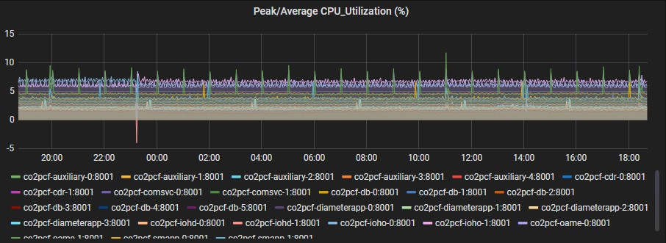
Nokia Policy Controller
Sample Screenshots

Slide 61
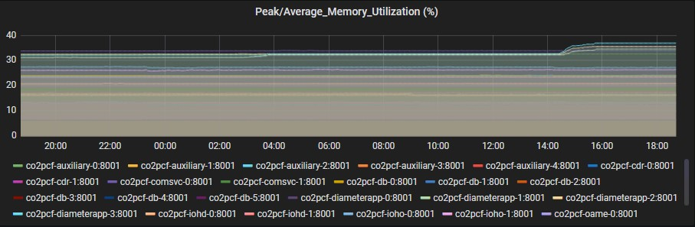
Nokia Policy Controller
Sample Screenshots (contd..)

Slide 62
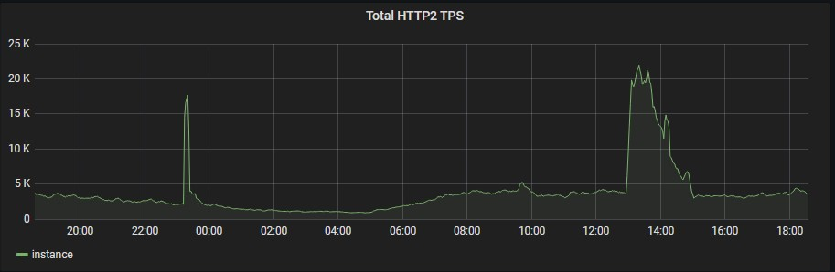
Nokia Policy Controller
Sample Screenshots (contd..)

Slide 63
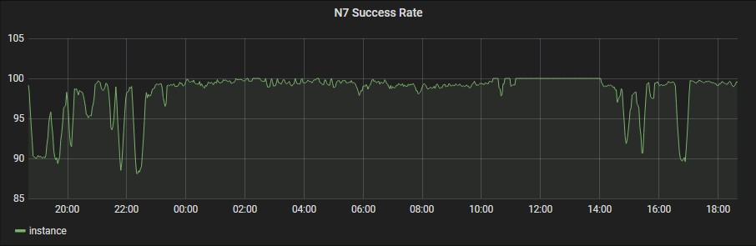
Nokia Policy Controller
Sample Screenshots (contd..)

Slide 64
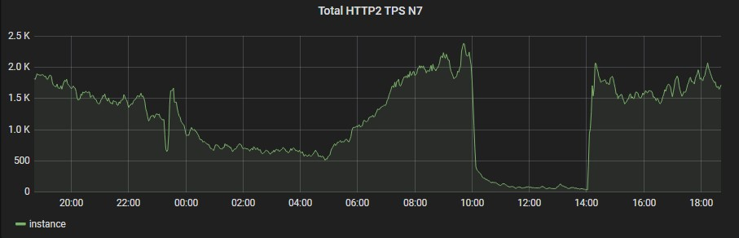
Nokia Policy Controller
Sample Screenshots (contd..)

Slide 65
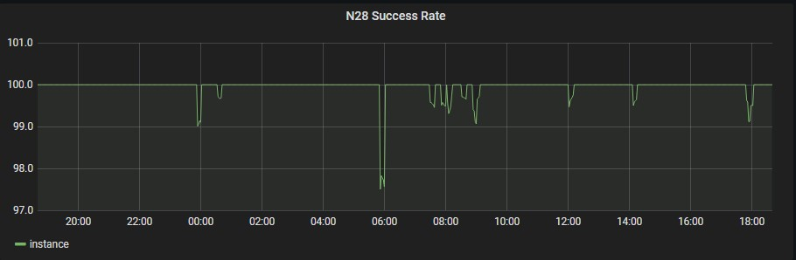
Nokia Policy Controller
Sample Screenshots (contd..)

Slide 66
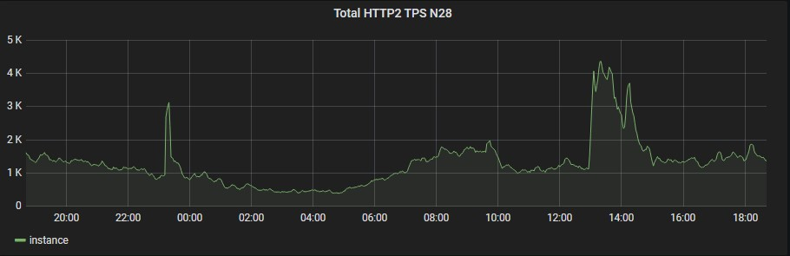
Nokia Policy Controller
Sample Screenshots (contd..)

Slide 67
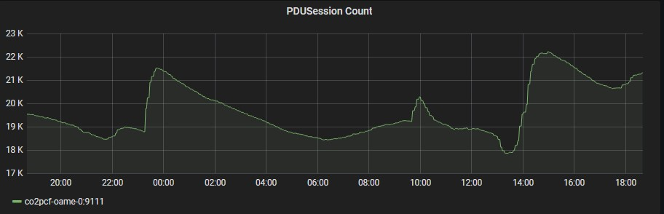
Nokia Policy Controller
Sample Screenshots (contd..)

Slide 68
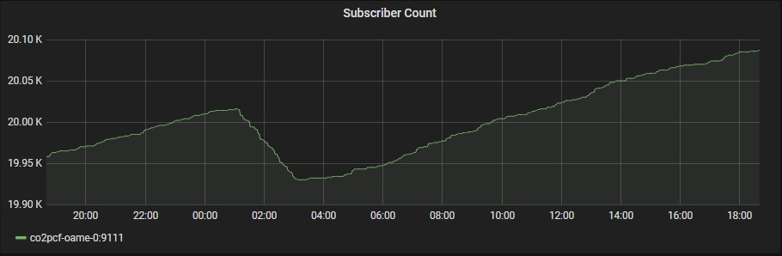
Nokia Policy Controller
Sample Screenshots (contd..)

Slide 69
NPC Deployment Pre-Requisites :
1. CIQ – containing the IP information/allocation subnets, flavour, vCPU, vRAM, vDISK, cinder information, custom system preference
2. Site LLD
3. CBIS/OpenStack GUI Access with Project User.
4. CBAM admin access to create spsclient user and extract secret key
Nokia CA Certificate of CBIS/OpenStack should be available locally.
Network creation
7. Flavor Creation as per NPC Dimensioning which will be configured in JSON file & required for allocating the resources.
8. Verification of the resources allotted to CBIS/OpenStack Project User for NPC deployment for Number of VM Instances, vRAM, vCPU, vDISK & Storage Volume .
9. Computes availability across different zones (Confirmation from cloud team that sufficient computes are available in Cloud Environment for NPC installation)

Slide 70
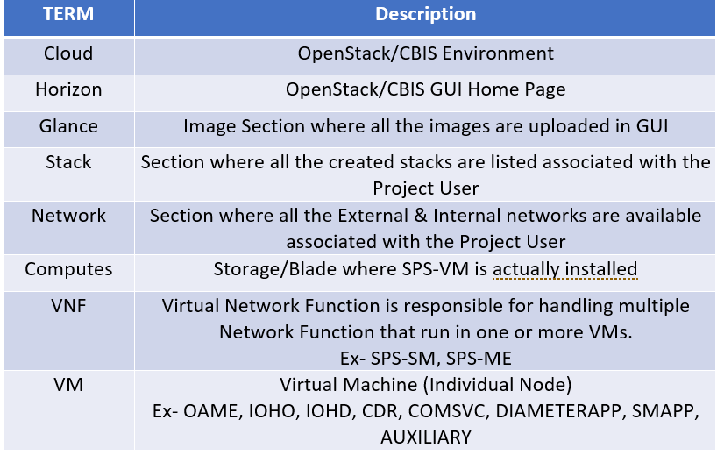
Cloud Terminology Overview
1. CIQ – containing the IP information/allocation subnets, flavour, vCPU, vRAM, vDISK, cinder information, custom system preference
2. Site LLD
3. CBIS/OpenStack GUI Access with Project User.
4. CBAM admin access to create spsclient user and extract secret key5. Nokia CA Certificate of CBIS/OpenStack should be available locally.
6. Flavor Creation as per NPC Dimensioning which will be configured in JSON file & required for allocating the resources.
7. Verification of the resources allotted to CBIS/OpenStack Project User for NPC deployment for Number of VM Instances, vRAM, vCPU, vDISK & Storage Volume (for Cinder Volume).
8. Computes availability across different zones (Confirmation from cloud team that sufficient computes are available in Cloud Environment for NPC installation)

Slide 71
NPC Deployment Preparation:
1. Cloud Setup Readiness for NPC Instantiation
2. Download Images
3. Upload Images
4. Network Creation
5. Flavor Creation
6. JSON File Preparation

Slide 72
NPC Deployment Preparation cont..
Cloud Setup Readiness for NPC Instantiation:
Nokia CA Certificate
Make sure that External & Internal Networks are already allocated to project & sufficient IP are available for NPC Installation along with CBAM.
Images should be downloaded & uploaded in Glance before starting respective Instantiation. ​

Slide 73
https://download-emea.support.nokia.com/cgi-bin/Download.pl
VNF Generator:
NPC Deployment Preparation cont..
CSAR Package:
NPC Images and CSAR packages download :
Images can be downloaded from below URLs:
https://download-emea.support.nokia.com/cgi-bin/Download.pl
VNF generator:
CSAR Packages:

Slide 74
Images download source
Maestro Images
https://repo3.cci.nokia.net/sps-generic-candidates/DevOps_images/
VNF Images
https://customer.nokia.com/support/s/

Slide 75
NPC Deployment Preparation cont..
CSAR Package:
Images required for NPC and Maestro:
Images Name
AUXILIARY QCOW2
CDR QCOW2
DATABASE QCOW2
SM_APP QCOW2
COMMON_SERVICES QCOW2
DIAMETER_IOH QCOW2
POLICY_CHARGING_APP QCOW2
OAME QCOW2
LOADBALANCER_ME QCOW2
LOADBALANCER_SMIG QCOW2
Maestro-HOT-2102.0.0-R1-73.yaml
Maestro-2102.0.0-R1-73.qcow2

Slide 76
NPC Deployment Preparation cont..
Network creation:
Use below mentioned command from undercloud hypervisor in order to perform network and Subnet creation
Command:
Network creation
neutron net-create G-5GSAKANSHI-VL1057-NPCData-ExtOAM --provider:network_type vlan --provider:physical_network physnet0 --provider:segmentation_id 1057
Subnet creation
neutron subnet-create --name G-5GSAKANSHI-VL1057-NPCData-ExtOAM_Subnet --gateway 10.16.26.206 G-5GSAKANSHI-VL1057-NPCData-ExtOAM 10.16.26.192/28
Use these two commands for all the networks mentioned in the IP sheet.

Slide 77
NPC Deployment Preparation cont..
Images Upload on CBIS:
Transfer these images one by one to undercloud hypervisor and then run glance command corresponding to image transferred.
Command:
#glance image-create --name <NPC version>.<image name or id> \--disk-format qcow2 \ --file <NPC version>.<image name or id>.qcow2 \ --container-format bare --property hw_vif_multiqueue_enabled=true
Command example:
#glance image-create --name SPS_21_8_I118.AUXILIARY --disk-format qcow2 --container-format bare --file SPS_21_8_R1_SPS_21_8_I118.AUXILIARY.qcow2 --property hw:vif_multiqueue_enabled=true

Slide 78
NPC Deployment Preparation cont..
Flavour Creation:
Use below mentioned commands from undercloud hypervisor in order to create flavour as per requirement mentioned in the LLD.
Example:
nova flavor-create c8_r12_d100 auto 12288 100 8
nova flavor-create c12_r12_d100 auto 12288 100 12
Change the cpu, ram and disk as per mentioned in LLD.

Slide 79
NPC Deployment Preparation cont..
JSON File Preparation
To prepare json file take details from the LLD and Ip sheet
1. From the downloaded images, untar the “OpenStack CSAR Package”.
2. Edit the JSON File Templates “SPS_21_8_I118_SM_VNF_CONF.json” and “SPS_21_8_I118_SM_SDC_CONFIG.json” for SM configuration.
3. Edit the JSON File Templates “SPS_21_8_I118_ME_VNF_CONF.json” and “SPS_21_8_I118_ME_SDC_CONFIG.json” for ME configuration.
4. Do not modify the default_conf.json files.
5. Enter the other parameter values wherever “<MUST FILL>” is mentioned in JSON files, which will include Internal/External Network Name, IP address, VIP address, cinder volume,etc.
6. Similarly fill the SDC Config file parameters.

Slide 80
Deploying maestro VM
Download maestro VM image and hot yaml file to UC node
https://repo.lab.pl.alcatel-lucent.com/policy-generic-candidates/DevOps_images/
Configure heat yaml file.
Deploy maestro VM as a heat stack

Slide 81
SM /ME Instantiation through Maestro

Slide 82
Prerequisite files for Instantiation through Maestro
ca.crt.pem
cbam2key.pem
openrc.sh file
cloud-config.yaml
5. SM & ME VNF and SDC files

Slide 83
SM Instantiation through Maestro
Execute SM instantiation command on Maestro:
Example:
/usr/local/bin/maestro ace sps-instantiate -d /opt/sps/SPS_21_2_I106 -i /opt/sps/configs/SPS_21_2_I106_SM_SDC_CONFIG.json -j /opt/sps/configs/SPS_21_2_I106_SM_VNF_CONF.json -s sm SPS_21_2_R1_SPS_21_2_I106

Slide 84
ME Instantiation through Maestro
Execute ME instantiation command on Maestro:
Example:
/usr/local/bin/maestro ace sps-instantiate -d /opt/sps/SPS_21_2_I106 -i /opt/sps/configs/SPS_21_2_I106_ME_SDC_CONFIG.json -j /opt/sps/configs/SPS_21_2_I106_ME_VNF_CONF.json -s me SPS_21_2_R1_SPS_21_2_I106

Slide 85
NPC deployment through CBAM

Slide 86
Deployment steps:
1. CBAM package creation through VNF generator for SM & ME
2. Upload CBAM packages on CBAM GUI to create Catalog
3. SM instantiation through CBAM
4. ME instantiation through CBAM
5. Validate stack on CBIS post Instantiation

Slide 87
Starting VNF generator tool on maestro VM
Download VNF generator tool to maestro VM
Download csar package to maestro VM
Create and prepare vnf generator workspace

Slide 88
CBAM package creation
CBAM Package creation on Maestro:
→ Make sure appropriate vnf generator packages are saved on Maestro
→ SM and ME VNF & SDC config files are placed on desired path /opt/sps/configs in Maestro

Slide 89
CBAM package creation
Commands to create CBAM package
→ For SM
./vnf_gen.py -i <path of SM_VNF_JSON file> -b -o /tmp/SM
Example: # ./vnf_gen.py -I /opt/sps/configs/SPS_21_5_I73_SM_VNF_CONF.json -b -o /tmp/SM
For ME:
./vnf_gen.py -i <path of SM_VNF_JSON file> -b -o /tmp/SM
Where SM & ME packages will be generated in /tmp
Example: ./vnf_gen.py -I /opt/sps/configs/SPS_21_5_I73_ME_VNF_CONF.json -b -o /tmp/ME

Slide 90
Catalog creation on CBAM for SM and ME:

Slide 91
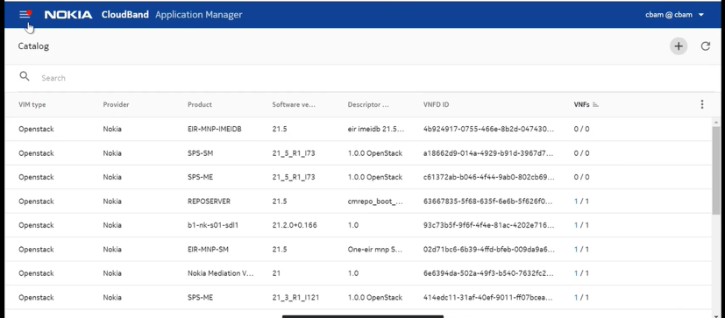
Catalog creation on CBAM:
In the CBAM GUI, click the options button with three horizontal lines and then select Catalog. The Catalog pane appears.
Commands to create CBAM package
→ For SM
./vnf_gen.py -i <path of SM_VNF_JSON file> -b -o /tmp/SM
Example: # ./vnf_gen.py -I /opt/sps/configs/SPS_21_5_I73_SM_VNF_CONF.json -b -o /tmp/SM
For ME:
./vnf_gen.py -i <path of SM_VNF_JSON file> -b -o /tmp/SM
Where SM & ME packages will be generated in /tmp
Example: ./vnf_gen.py -I /opt/sps/configs/SPS_21_5_I73_ME_VNF_CONF.json -b -o /tmp/ME

Slide 92
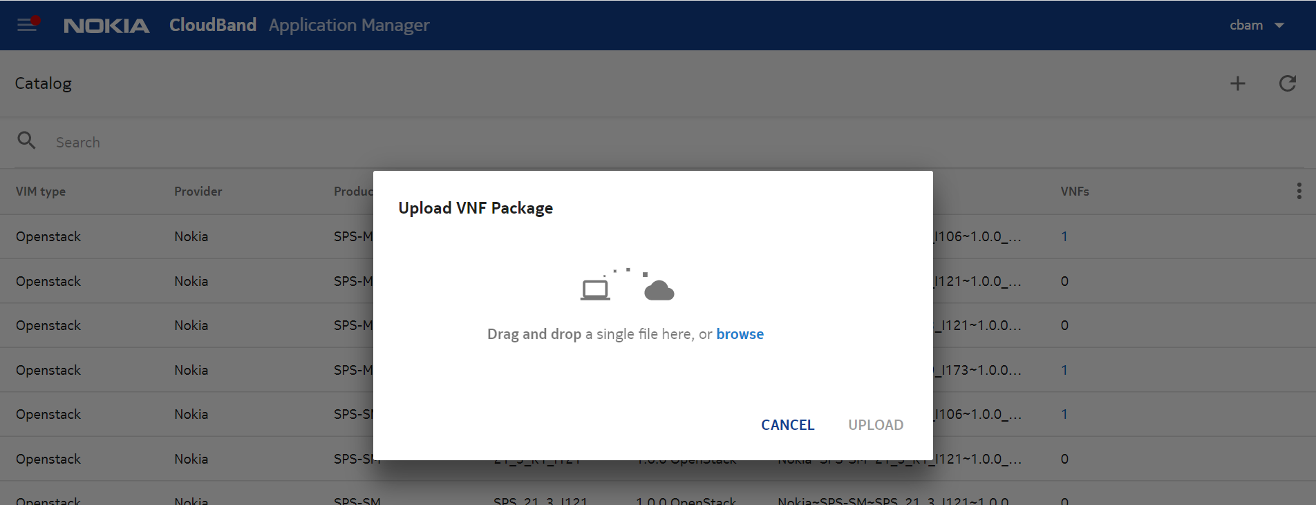
Catalog creation on CBAM:
Upload VNF package for SM:
Commands to create CBAM package
→ For SM
./vnf_gen.py -i <path of SM_VNF_JSON file> -b -o /tmp/SM
Example: # ./vnf_gen.py -I /opt/sps/configs/SPS_21_5_I73_SM_VNF_CONF.json -b -o /tmp/SM
For ME:
./vnf_gen.py -i <path of SM_VNF_JSON file> -b -o /tmp/SM
Where SM & ME packages will be generated in /tmp
Example: ./vnf_gen.py -I /opt/sps/configs/SPS_21_5_I73_ME_VNF_CONF.json -b -o /tmp/ME

Slide 93
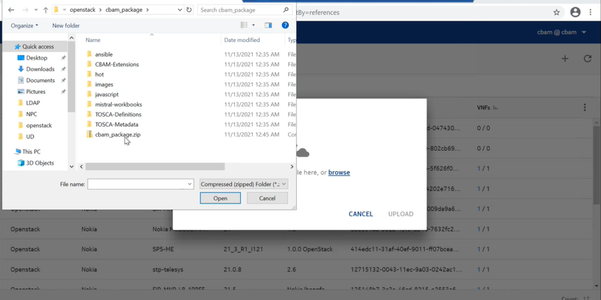
Catalog creation on CBAM:
Commands to create CBAM package
→ For SM
./vnf_gen.py -i <path of SM_VNF_JSON file> -b -o /tmp/SM
Example: # ./vnf_gen.py -I /opt/sps/configs/SPS_21_5_I73_SM_VNF_CONF.json -b -o /tmp/SM
For ME:
./vnf_gen.py -i <path of SM_VNF_JSON file> -b -o /tmp/SM
Where SM & ME packages will be generated in /tmp
Example: ./vnf_gen.py -I /opt/sps/configs/SPS_21_5_I73_ME_VNF_CONF.json -b -o /tmp/ME

Slide 94
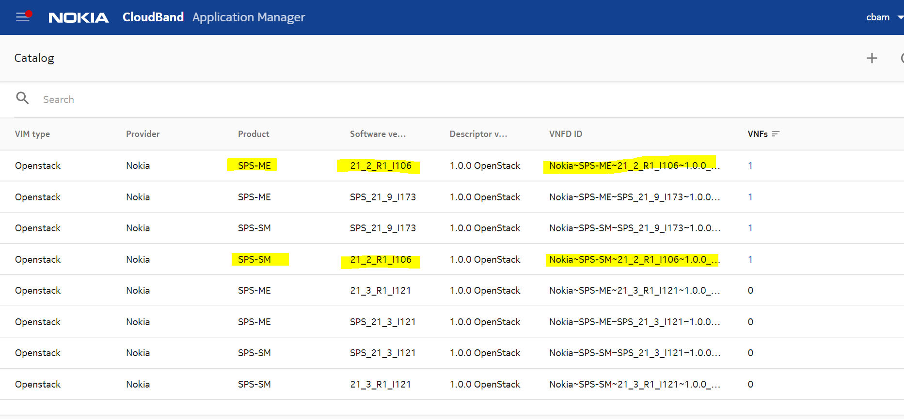
Catalog creation on CBAM:
Commands to create CBAM package
→ For SM
./vnf_gen.py -i <path of SM_VNF_JSON file> -b -o /tmp/SM
Example: # ./vnf_gen.py -I /opt/sps/configs/SPS_21_5_I73_SM_VNF_CONF.json -b -o /tmp/SM
For ME:
./vnf_gen.py -i <path of SM_VNF_JSON file> -b -o /tmp/SM
Where SM & ME packages will be generated in /tmp
Example: ./vnf_gen.py -I /opt/sps/configs/SPS_21_5_I73_ME_VNF_CONF.json -b -o /tmp/ME

Slide 95
NPC SM & ME Instantiation Steps:
After Catalog creation for SM & ME, Follow below procedure for SM & ME
In the CBAM GUI, do the following:
i. Create SM/ME VNF with a particular CSAR package using the procedure Creating VNF
ii. Modify this SM/ME VNF with the VNF Extension file generated for this VNF using the procedure Modifying VNF.
iii. Instantiate SM/ME VNF with the Scalable file generated for this VNF using the procedure Instantiating VNF.

Slide 96
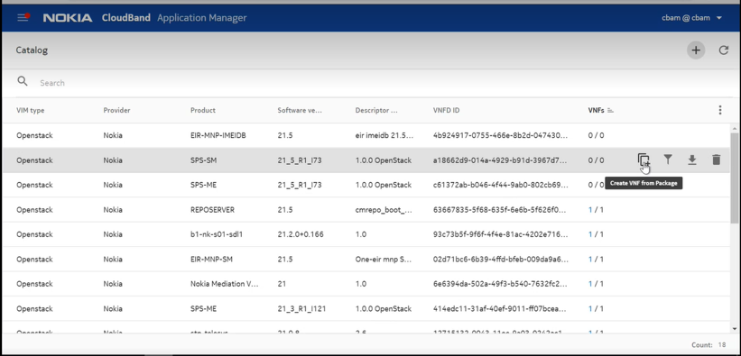
Create VNF for SM

Slide 97
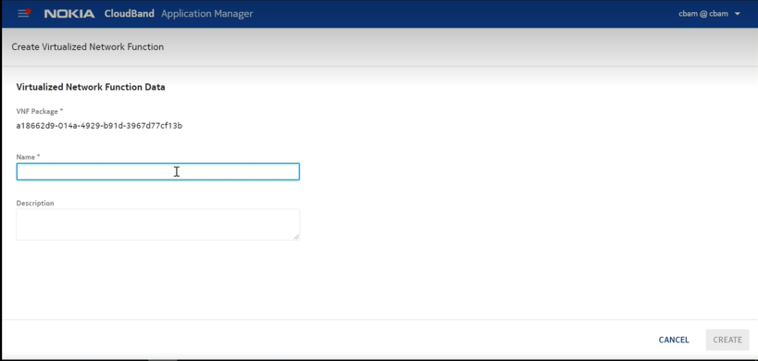
Create VNF for SM

Slide 98
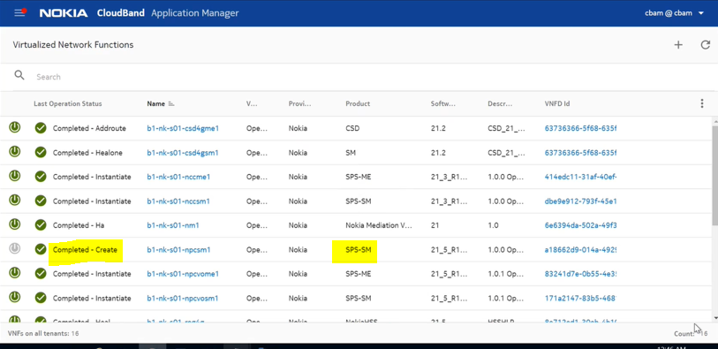
Create VNF for SM

Slide 99
Modify VNF for SM

Slide 100
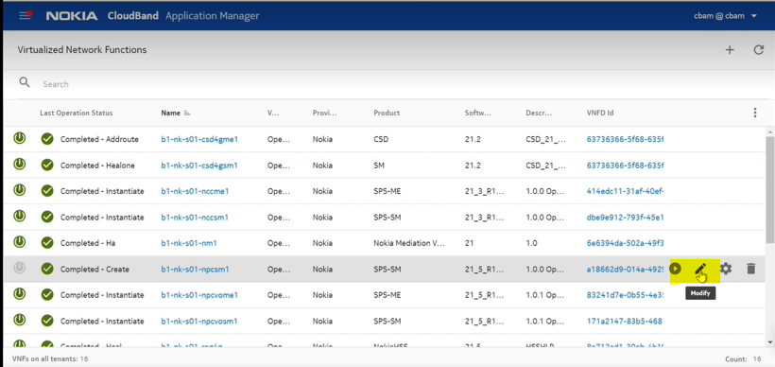
Modify VNF for SM

Slide 101
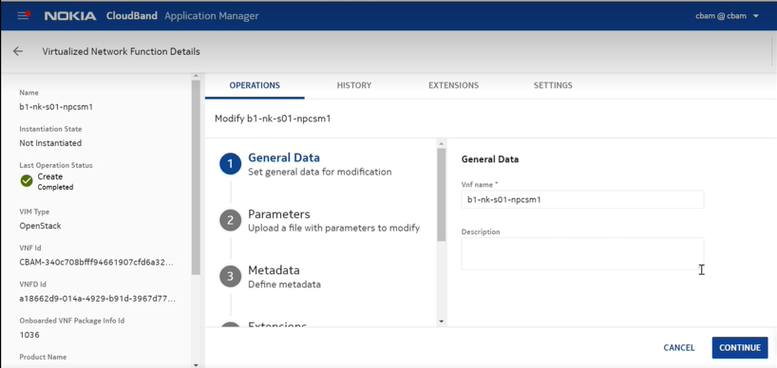
Modify VNF for SM

Slide 102
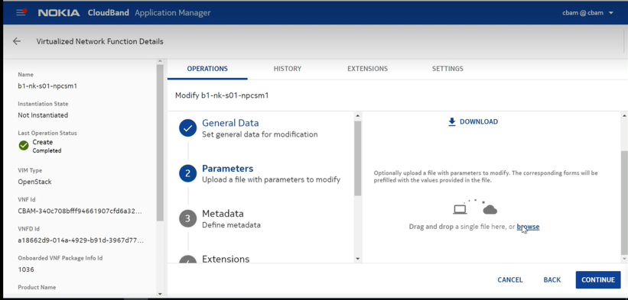
Modify VNF for SM

Slide 103
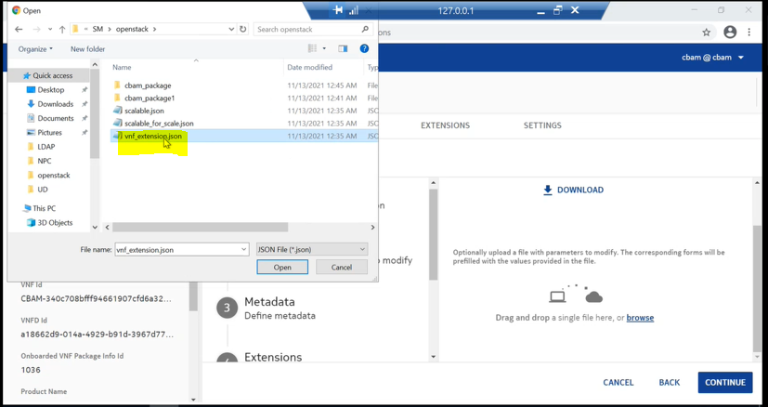
Modify VNF for SM

Slide 104
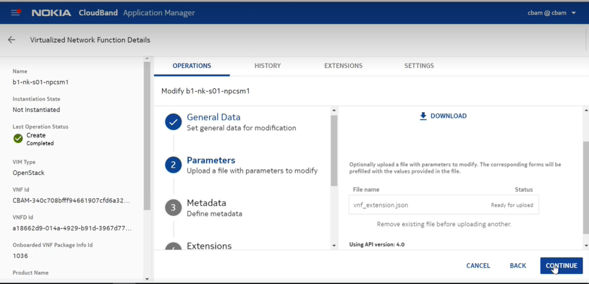
Modify VNF for SM

Slide 105
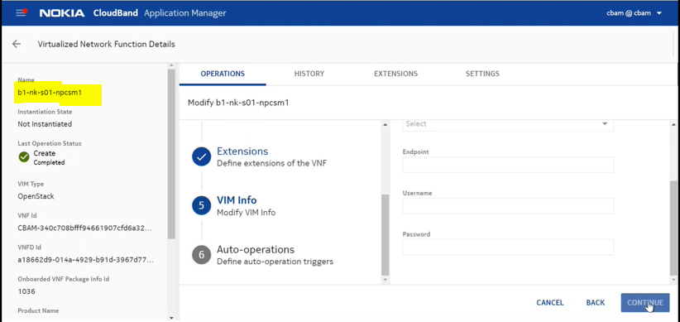
Modify VNF for SM

Slide 106
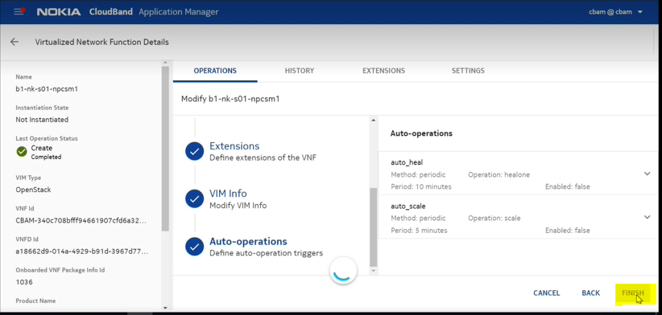
Modify VNF for SM

Slide 107
INSTANTIATE SM VNF

Slide 108
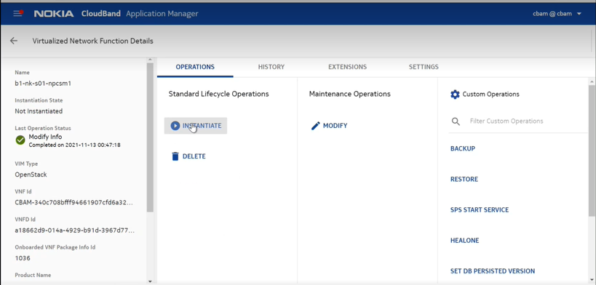
Instantiate SM VNF

Slide 109
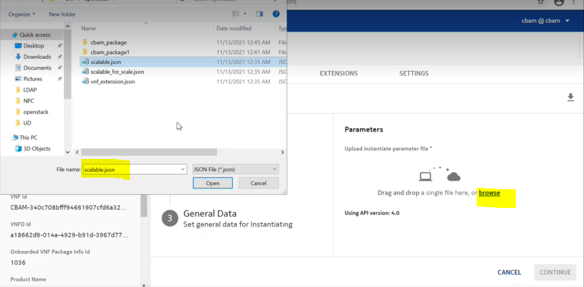
Instantiate SM VNF

Slide 110

Instantiate SM VNF

Slide 111

Instantiate SM VNF

Slide 112

Instantiate SM VNF

Slide 113

Instantiate SM VNF

Slide 114

Instantiate SM VNF

Slide 115

Instantiate SM VNF

Slide 116

Instantiate SM VNF

Slide 117

Instantiate SM VNF

Slide 118
INSTANTIATE ME VNF
1. Create VNF for ME
2. Modify ME VNF
3. Instantiate ME VNF

Slide 119

Create VNF for ME

Slide 120

Create VNF for ME

Slide 121
Modify ME VNF

Slide 122

Modify ME VNF

Slide 123

Modify ME VNF

Slide 124

Modify ME VNF

Slide 125

Modify ME VNF

Slide 126

Modify ME VNF

Slide 127

Modify ME VNF

Slide 128
INSTANTIATE ME VNF

Slide 129

Instantiate ME VNF

Slide 130

Instantiate ME VNF

Slide 131

Instantiate ME VNF

Slide 132

Instantiate ME VNF

Slide 133

Instantiate ME VNF

Slide 134

Instantiate ME VNF

Slide 135

Instantiate ME VNF

Slide 136

Instantiate ME VNF

Slide 137
Validate Stack creation on CBIS GUI

Slide 138

Validate Stack on CBIS GUI

Slide 139

VNF status on CBAM

Slide 140
Deployment
Installation Guide/Release Notes to be downloaded from NOLS - Link
Sample JSON file
Health Check-up
Check the status of services

Slide 141
Documentation Navigation
VNF Overview
Link
VNF Installation and Upgrade Guide
Link
VNF Operation Administration and Maintenance Guide
Link
Policy User Guide
Link
Training Session
Link

Slide 142
NPC
Access Network Charging Identifier
Ivo Tanouchev
03-06-2022

Slide 143
Agenda
Feature overview
Access Network Charging Identifier operation
SM view

Slide 144
Feature overview
NPCART-134 scope
Tittle: NPCART-134 Access Network Charging Identifier Support
The EPIC asks to support propagation of N7 session Access Network Charging Identifier to AF when such is requested
The exchange with IMS applies to both Gx and N7 as well as Rx and N5. NPC Release 22.5 does not support N5 interface, and the focus of this feature is Rx to N7
Confidential. Not for distribution or disclosure outside NOKIA

Slide 145
Feature overview
NPCART-134 team
Sravan Sajeev, design
Nadia Spido, QA
Ivo Tanouchev, PO
Confidential. Not for distribution or disclosure outside NOKIA

Slide 146

Feature overview
Day one of TS 29.214, Rel 7 even
TS 29.212 only talks about it in Rel 8, Version 8: CHARGING_CORRELATION_EXCHANGE (28)
3GPP Procedure
The AF may request to the PCF the Access Network Charging Identifier by subscribing to the CHARGING_CORRELATION_EXCHANGE (1) within the Specific-Action AVP
The PCF shall provide the Access Network Charging Identifier in the Rx:AA Answer if already known
If not known, PCF shall request the identifier to the SMF by including the "PolicyCtrlReqTriggers" attribute with the value "AN_CH_COR“ , if not already installed; and the "lastReqRuleData" attribute
When the PCF gets the identifier from SMF, it shall send Rx:RAR to the AF with the obtained identifier
There could be different Access Network Charging Identifier per service flow i.e., dynamic PCC rule
TS 29.212 Rel. 12.9, from 24-07-2015 added support/indication for IP-CAN-Session-Charging-Scope
Automatically available in TS 29.512 for 5G N7 SBI
NPC did not support this for 4G Diameter, and no specific work was done either, but added support for the AVP
The 5G way of doing it
Confidential. Not for distribution or disclosure outside NOKIA

Slide 147
Agenda
Feature overview
Access Network Charging Identifier operation
SM view

Slide 148
Access Network Charging Identifier operation
One liner, or two
Access Network Charging Identifier operation is handled by NPC code. There is no Rules logic involved
Unlike similar functionalities, there is no Feature number involved
Confidential. Not for distribution or disclosure outside NOKIA

Slide 149

Access Network Charging Identifier – session level Acc Net Charg Id
UE1
SMF
NPC
AF
NPC replies with the AN Ch Id regardless of the SA, legacy operation
Npcf_SMPolicyControl_Create
“accNetChId“ {
"accNetChaIdValue":12345678,
"sessionChScope":true }
Response
Rx: AAR Specific-Action=CHARGING_CORRELATION_EXCHANGE (1)
Rx: AAA
Access-Network-Charging-Identifier: Access-Network-Charging-Identifier-Value=12345678
Npcf_SMPolicyControl_UpdateNotify "pccRules":{ "dynpcc1":{ "pccRuleId":"dynpcc1“}},
"lastReqRuleData":[ {
"refPccRuleIds": [“dynpcc1"], "reqData": [”CH_ID”]
} ],
“policyCtrlReqTriggers” = [”AN_CH_COR”]
NPC will not request Triggers
If already known
No obvious clause if PCF shall install triggers for the known case
TS 29.512
Confidential. Not for distribution or disclosure outside NOKIA

Slide 150



Access Network Charging Identifier operation
Access Network Charging Identifier – session level Acc Net Charg Id
SMF provides the Access Network Charging Identifier in the Request and includes Session scope
Access Network Charging Id in Rx:AAA
No trigger installed with the installation of PCC rules
Confidential. Not for distribution or disclosure outside NOKIA

Slide 151

Access Network Charging Identifier – session level Acc Net Charg Id
UE1
SMF
NPC
AF
Npcf_SMPolicyControl_Create
If Access Network Charging Id is not known
Response
Rx: AAR Specific-Action=CHARGING_CORRELATION_EXCHANGE (1)
Rx: AAA
Npcf_SMPolicyControl_UpdateNotify "pccRules":{ "dynpcc1":{ "pccRuleId":"dynpcc1“}},
"lastReqRuleData":[ {
"refPccRuleIds": [“dynpcc1"], "reqData": [”CH_ID”]
} ],
“policyCtrlReqTriggers” = [”AN_CH_COR”]
TS 29.214
Npcf_SMPolicyControl_Update
"repPolicyCtrlReqTriggers":[ “AN_CH_COR" ],
“accNetChIds“:[{
"accNetChaIdValue":12345678,
"sessionChScope":true }]
"ruleReports": [ {
"pccRuleIds":[“dynpcc1"],
"ruleStatus":"ACTIVE“
} ]
Rx: RAR Specific-Action= CHARGING_CORRELATION_EXCHANGE (1),
Access-Network-Charging-Identifier: Access-Network-Charging-Identifier-Value=12345678
Not clear we get this
NPC will report this exact AVP structure in the Rx: RAR
Confidential. Not for distribution or disclosure outside NOKIA

Slide 152




Access Network Charging Identifier operation
Access Network Charging Identifier – session level Acc Net Charg Id
No Access Network Charging Identifier in the SMF initial Request
No Access Network Charging id
Installing triggers
SMF Update
Rx:RAR
Confidential. Not for distribution or disclosure outside NOKIA

Slide 153
Access Network Charging Identifier – flow level Acc Net Charg Id
UE1
SMF
NPC
AF
Npcf_SMPolicyControl_Create
Response
Rx: AAR Specific-Action=CHARGING_CORRELATION_EXCHANGE (1)
Npcf_SMPolicyControl_UpdateNotify "pccRules":{ "dynpcc1":{ "pccRuleId":"dynpcc1"}},
"lastReqRuleData":[ {
"refPccRuleIds": ["dynpcc1", "dynpcc2",…], "reqData": ["CH_ID"]
} ],
"policyCtrlReqTriggers" = ["AN_CH_COR"]
Rx: AAA
Multiple PCC rules possible
Npcf_SMPolicyControl_Update
"repPolicyCtrlReqTriggers":["AN_CH_COR" ],
"accNetChIds" [
{
"accNetChaIdValue":12345678,
"refPccRuleIds”:["dynpcc1", "dynpcc2"]
},
{
"accNetChaIdValue":87654321,
"refPccRuleIds": ["dynpcc3", "dynpcc4"]
}
]
Rx: RAR Specific-Action= CHARGING_CORRELATION_EXCHANGE (1),
Access-Network-Charging-Identifier: Access-Network-Charging-Identifier-Value=12345678
Flows:
Media-Component-Number = 1,
Flow-Number =1,
Flow-Number = 2
Access-Network-Charging-Identifier: Access-Network-Charging-Identifier-Value=87654321
Flows:
Media-Component-Number = 2,
Flow-Number = 1,
Flow-Number = 2
Report can be per PCC rule or most likely per QCI
e.g., two flows: RTP, RTCP
Confidential. Not for distribution or disclosure outside NOKIA

Slide 154


Access Network Charging Identifier operation
Access Network Charging Identifier – per PCC rule level Acc Net Charg Id
No Access Network Charging Identifier in the SMF initial Request
Specify the Charging Id against the Service Flow
No Access Network Charging id
Installing triggers
SMF Update, Charging Id per PCC rule
Confidential. Not for distribution or disclosure outside NOKIA

Slide 155
Access Network Charging Identifier – Access Network Charging Address
Not part of initial V15.1.0
UE1
SMF
NPC
AF
Npcf_SMPolicyControl_Create
" accNetChIds " {
"accNetChaIdValue":12345678,
"sessionChScope":true }
"chargEntityAddr": {"anChargIpv4Addr":"10.10.10.10"}
Can be received here as well
Response
Rx: AAR Specific-Action=CHARGING_CORRELATION_EXCHANGE (1)
Rx: AAA
Access-Network-Charging-Identifier: Access-Network-Charging-Identifier-Value=12345678
Npcf_SMPolicyControl_UpdateNotify "pccRules":{ "dynpcc1":{ "pccRuleId":"dynpcc1"}},
"lastReqRuleData":[ {
"refPccRuleIds": ["dynpcc1"], "reqData": [”CH_ID”]
} ],
"policyCtrlReqTriggers" = ["AN_CH_COR"]
Npcf_SMPolicyControl_Update
"repPolicyCtrlReqTriggers":[ “AN_CH_COR" ],
" accNetChIds " {
"accNetChaIdValue":12345678,
"sessionChScope":true }
"chargEntityAddr": {"anChargIpv4Addr":"10.10.10.10"}
Rx: RAR Specific-Action= CHARGING_CORRELATION_EXCHANGE (1),
Access-Network-Charging-Identifier: Access-Network-Charging-Identifier-Value=12345678
Access-Network-Charging-Address = 10.10.10.10
Outside accNetchIds, single value
Confidential. Not for distribution or disclosure outside NOKIA

Slide 156



Access Network Charging Identifier – Access Network Charging Address
The 3GPP challenge
TS 29.512
TS 29.214
"chargEntityAddr":{
"anChargIpv4Addr":"172.17.104.241",
"anChargIpv6Addr":"1111:111:111:111:111:305:1002:8010",
}
Nested attribute
For NPC chosen to propagate the IPv4 to AF if both present….
Optional (Single)
Multiple, Optional
Confidential. Not for distribution or disclosure outside NOKIA

Slide 157

Access Network Charging Identifier operation
Identifier examples
T-Mobile -> no ccNetChId in N7 Request
BELL
0x6943CFFE
TELUS 4G
Confidential. Not for distribution or disclosure outside NOKIA

Slide 158
Agenda
Feature overview
Access Network Charging Identifier operation
SM view

Slide 159


SM view
Access Network Charging Identifier support
The support for the Identifier at the PDU session was not completed in 22.5, created NPCART-5688
Currently no Access Network Charging Identifier details are shown in the SM for the PDU session
Re-labeled the “header”, also replaced “AN” with “Access Network” , re-arranged the rows
AF session in SM does not show Access Network Charging Identifier, but has it in Aerospike
Old labels (IPCAN)
4G format really, may change to indicate v4 and v6 addresses
The AN Charging Id if session level
Will be adding Session Scope flag (perhaps redundant)
The Id reported per Service Flow / PCC
Confidential. Not for distribution or disclosure outside NOKIA

Slide 160


Slide 161
Access Network Charging Identifier – 4G Diameter operation
UE1
PGw
NPC
AF
Gx:CCR(I)
Access-Network-Charging-Identifier-Gx:
Access-Network-Charging-Identifier-Value = 123456,
IP-CAN-Session-Charging-Scope = 0,
Access-Network-Charging-Address
1. NPC would reject the AVP, now ok with 22.5
Gx:CCA
Rx: AAR Specific-Action=CHARGING_CORRELATION_EXCHANGE (1)
Rx: AAA
Access-Network-Charging-Identifier: Access-Network-Charging-Identifier-Value=123456
Gx:RAR Charging-Rule-Install::=
Charging-Rule-Definition::= dynpcc1, dynpcc2,
Charging-Correlation-Indicator = 0,
ET=CHARGING_CORRELATION_EXCHANGE (28)
2. NPC sends this to IMS whether asked or not
Gx:CCR(U)
ET=CHARGING_CORRELATION_EXCHANGE (28),
Access-Network-Charging-Identifier-Gx:
Access-Network-Charging-Identifier-Value = 123,
IP-CAN-Session-Charging-Scope = 0,
Access-Network-Charging-Address
Gx:CCR(U)
ET=CHARGING_CORRELATION_EXCHANGE (28),
Access-Network-Charging-Identifier-Gx:
Access-Network-Charging-Identifier-Value = 123,
Charging-Rule-Name = dynpcc1
Access-Network-Charging-Identifier-Gx:
Access-Network-Charging-Identifier-Value = 456,
Charging-Rule-Name = dynpcc2
Access-Network-Charging-Address
Rx: RAR Specific-Action= CHARGING_CORRELATION_EXCHANGE (1),
Access-Network-Charging-Identifier: Access-Network-Charging-Identifier-Value=123
Flows:
Media-Component-Number = 1,
Flow-Number =1,
Flow-Number = 1
Access-Network-Charging-Identifier: Access-Network-Charging-Identifier-Value=456
Flows:
Media-Component-Number = 1,
Flow-Number = 1,
Flow-Number = 2
3. Ether message results in the same response
3’. NPC always reports this format to IMS
Confidential. Not for distribution or disclosure outside NOKIA

Slide 162
5G handling of Access-Network-Charging-Id
Commands
N7 Request
N7 Update – session level
N7 Update – per pcc rule
N7 Update – per flow
Aerospike commands
/usr/bin/curl -k -v -POST --http1.0 -H 'Content-Type: application/json' -d '{"supi": "imsi-310214000000051", "pduSessionId": "127", "pduSessionType": "IPV4", "dnn": "network1", "accessType": "3GPP_ACCESS", "ratType": "EUTRA", "servingNetwork" : {"mcc": 310, "mnc": 210}, "pei": "imei-8888888866666622", "ipDomain" : "Domain1", "ueTimeZone": "-08:00", "online": true, "offline": true, "3gppPsDataOffStatus": true, "ipv4Address": “11.1.3.50", "ipv6AddressPrefix": "1111:111:111:111:111:305:1002:8010", "notificationUri": "http://y.y.y.y:8082/npcf-smpolicycontrol/v1/sm-policies/n7-700001", "subsSessAmbr": {"uplink" : "100 Kbps", "downlink" : "100 Kbps"}, "refQosIndication": true, "subsDefQos": {"5qi": "9", "arp": {"priorityLevel": "9", "preemptCap": "NOT_PREEMPT", "preemptVuln": "NOT_PREEMPTABLE"}}, "suppFeat": "3D","sliceInfo":{"sst":1,"sd":"00009B"}, "accNetChId":{"accNetChaIdValue":1766051838,"sessionChScope":true}, "chargEntityAddr":{"anChargIpv4Addr":"172.17.104.241"}}' http://x.x.x.x:8080/npcf-smpolicycontrol/v1/sm-policies;
/usr/bin/curl -k -v -POST --http1.0 -H 'Content-Type: application/json' -d '{"repPolicyCtrlReqTriggers": ["AN_CH_COR"], "accNetChIds":[{"accNetChaIdValue":12345679,"sessionChScope":true}], "chargEntityAddr":{"anChargIpv4Addr":"172.17.104.241"}}' http://x.x.x.x:8080/npcf-smpolicycontrol/v1/sm-policies/N7-sps-ig-4-536f8e12-1757-4d90-ac45-3638ca6ab05b/update;
/usr/bin/curl -k -v -POST --http1.0 -H 'Content-Type: application/json' -d '{"repPolicyCtrlReqTriggers": ["AN_CH_COR"], "accNetChIds":[{"accNetChaIdValue":12345680,"refPccRuleIds":["MT:AUDIO MCN:1 FN:1 Rule#:1","MT:AUDIO MCN:1 FN:2 Rule#:2"]}], "chargEntityAddr":{"anChargIpv4Addr":"172.17.104.241"}}' http://x.x.x.x:8080/npcf-smpolicycontrol/v1/sm-policies/N7-sps-ig-4-536f8e12-1757-4d90-ac45-3638ca6ab05b/update;
/usr/bin/curl -k -v -POST --http1.0 -H 'Content-Type: application/json' -d '{"repPolicyCtrlReqTriggers": ["AN_CH_COR"], "accNetChIds":[{"accNetChaIdValue":12345680,"refPccRuleIds":["MT:AUDIO MCN:1 FN:1 Rule#:1"]},{"accNetChaIdValue":12345999,"refPccRuleIds":["MT:AUDIO MCN:1 FN:2 Rule#:2"]}], "chargEntityAddr":{"anChargIpv4Addr":"172.17.104.241"}}' http://x.x.x.x:8080/npcf-smpolicycontrol/v1/sm-policies/N7-sps-ig-4-536f8e12-1757-4d90-ac45-3638ca6ab05b/update;
aql -o json -c "select * from spspd1.SessionContainer"
Confidential. Not for distribution or disclosure outside NOKIA

Slide 163


IPCAN session - before
Header about the Address but below is also the actual identifier
Sy session id reference appears in a “wrong place”
Completely out of place label for Location Info
Not sure what is this…
Location Info under Maximum Bandwidth
Confidential. Not for distribution or disclosure outside NOKIA

Slide 164



IPCAN session - new
Removed header User Location
Section moved furter down
Label changed from AN Charging Address to Access Network Charging Information
Label changed from
AN Charging Id Value to
Access Network Charging identifier
The AVP name is not abbreviated, it is Access-Network; it is a grouped AVP indeed, no need to use the internal AVP with the “Value”
Removed Sy/Nchf Session Id from here, moved further down
Added the header and section here
Moved Logical and Physical Ids here, logically they belong here, they were added by 3GPP for Wireline
Moved Sy/NCHF here
Confidential. Not for distribution or disclosure outside NOKIA

Slide 165
Agenda
Product overview & main benefits
Product functionalities
Interfaces & integration capabilities
Policy Rules
Main use cases

Slide 166
Nokia Policy Controller
Key benefits
Comprehensive set of field-proven capabilities addresses wide range of use cases for 4G and 5G
Flexibility and simplicity in creating rules speeds up time to market
Production-level quality for 5G today!
Interoperability: Ease of network integration with built-in protocol manipulation
Leverages Nokia’s Common Software Foundation for speed, quality, and serviceability
Cloud-native with independently scalable sub-functions; stateless, microservices-based architecture with 99.999% application reliability
Always up-to-date: continuous delivery with in-service upgrades and automation via DevOps tools
Simplicity and ease-of-use based on common A.R.T. rule system with 150+ patents
Designed for fast multi-vendor deployments and fully pre-integrated with Nokia solutions such as Cloud Core

Slide 167



Nokia Policy Controller
Built for the demands of 5G and the scale of IoT
Ultra high bandwidth / massive numbers of devices
5G and IoT bring new demands on the core
Low latency / mobile edge computing
Enable new use cases
Network slicing
Increased flexibility for classes of devices
Could native architecture
Provides scale, performance and flexibility

Slide 168
Nokia Policy Controller
Rule engine highlights
The A.R.T. rules engine enables highly tailored, carrier-grade, policy control.
New policy defined with in-product rules – not product change requests
Empower innovation in marketing and services
Roll out new policy easily, with rollback
Compiled into a highly optimized form
Tailored policy – without sacrificing performance and scalability
4G and 5G policy in one place
150+ patents

Slide 169
Agenda
Product overview & main benefits
Product functionalities
Interfaces & integration capabilities
Policy Rules
Main use cases

Slide 170
NPC Architecture
Layered Architecture View

Slide 171
NPC Deployment Architecture
Mode of deployment – SM and ME

Slide 172
NPC geo-redundancy
1+1 mated pair
SM sites are Active-Standby (hot)
Service definition: SM has master copy & distributes to sites
SM selects device home or is instructed by OSS
SM maintains the device home location & each ME does geo-replication
REST SOAP
SM1
Geo-replication
SM2
OSS
ME sites are Active-Active – No idle hardware
NPC Site #1
NPC Site #2
NPC Site #3
NPC Site #4
NPC Site #5
NPC Site #6
ME
ME
ME
ME
ME
ME
Geo-replication
Geo-replication
Geo-replication
Region 1
Region 2
Region 3
Multi-node support increases deployment flexibility for large operators by dividing into regions and supporting a combination of Policy and Charging nodes
Notes:
reliability

Slide 173
NPC SM & ME systems configured with all modules
5G, Diameter peers
Operation and Management, logging
Provisioning, API requests, SPR traffic
Operation and Management, logging
Provisioning,
API requests,
SPR traffic
Provisioning, API requests
Notifications,
IT system interaction
API to SPSs, IPv6 to ME
IOH
Core
IOH
API
IOH
OAME
OAME
CDR
SM App
Apps
ComSvcs
AUX*
AUX*
DB
DB
NPC SM System
NPC ME System
DB replication
Legend for VM engineering:
DB replication
SU VM groups shown as gold, blue, and green boxes
* Aux VMs host Service Discovery and Configuration (SDC) and always use exactly 5 VMs
1 + 1
N + K
2*(N + K)

Slide 174
NPC VNF lifecycle management
Via Nokia CBAM VNFM
Create
Instantiate
Modify
Heal, auto-Heal
Backup, restore
Disaster recovery
Terminate
Delete
Scale out/in, auto-scale
Upgrade
Life Cycle Events
Instantiate VNF
Healing
Scale out /Scale –In
Terminate VNF
Delete VNF
Backup and Restore
VNF Network Upgrade
VNF Disaster recovery
Auto Healing
Auto Scaling

Slide 175
Agenda
Product overview & main benefits
Product functionalities
Interfaces & integration capabilities
Policy Rules
Main use cases

Slide 176
Policy Management
Sample policy behaviors
NPC can provide the following to gateways (and TDFs)
QoS, including rates (down/up) and priority
PCC rules to define gateway behavior for a session/flow
Redirects
Charging related policies (such which rating group to use)
NPC can accept or reject/terminate sessions
It can register for events from the gateways (and TDFs)
Be notified when events occur, such as a RAT Type change
Receive a ‘call back’ from a gateway (Revalidation Timeout)
Usage monitoring, such as reporting when a UE has used 20MB of data
Policies are provided on request and can be pushed for updates

Slide 177
Policy Management
Policy control
NPC provides the Policy Charging and Rules Function (PCRF) in 4G/LTE
It provides policy to gateways (PCEFs) and other elements such as traffic detection elements (TDFs)
NPC provides the Policy Control Function (PCF) in 5G
Both can be provided in the same NPC instance – a combined PCRF+PCF
NPC can provide tailored policy based on a wide variety of inputs, including
Subscription type
Type of device
Location (such as MCC/MNC, GGSN IP address, cell tower)
Configured subscriber/device data
Time of day / day of week
Usage related policies, such as CHF/OCS counter values

Slide 178
Policy Management
Networks need policy management
OSS/BSS
SPR
AF/IMS
Provides policy to network elements to enable subscriber experience
Ud LDAP
IMS
REST
Rx
NPC can use NCC or a third-party OCS.
Sy
NPC
OCS
PCRF
Charging
GERAN
Gx
MME
Sd
RNC
SGSN/SGw
GGSN/PGw
DPI
CDN/ Video Opt.

Slide 179
NPC interfaces
Gx, Rx and Sy
Gx interface
Gateways (PCEFs) request policy for sessions
Policy can be highly customized using NPC rules
Changes in policy can be pushed to the gateways, such as due to a charging counter change or a provisioning change
Gateways notify NPC of network changes
Rx interface
Requests IMS bearers, eg voice (VoLTE) and video (ViLTE) and NPLI support
Typically works out-of-the-box with preset media type-QCI mappings
NPC adds Rx/Af support for independent voice/video allow/block which can be dependent on OCS counters
Sy interface
For use with NCC or 3rd party OCS
Policy can query the OCS counters and states
OCS notifies PCRF of changes in counters and states
NPC has support for multiple OCS, configured globally or per device

Slide 180
NPC interfaces
Sd, LDAP/Ud and RADIUS
Sd Interface
Provides policy to traffic detection function (TDF) elements such as a DPI
Can be triggered on policy changes, in addition to policy provided over Gx
LDAP/Ud
Used for subscriber related lookups to an external SPR
Typically handed by a custom external SPR plugin which adapts the customer schema to the NPC schema

Slide 181
NPC interfaces
Subscriber & External SPR/UDR
Internal SPR
Refers to users/devices being provisioned in NPC database
Device primary site can be optionally provided at provisioning. If not provided, NPC will select in round robin fashion
Primary site selection based on load and load rebalancing (roadmap)
External SPR/UDR
NPC retrieves data and caches it (audit for stale records supported)
Plug-in used by services to adapt the external schemas
Support for notifications to update cached fields
NPC adds support for SPR write-back
Nokia SPR/UDR
Leverage Nokia OneNDS and Nokia SDL (subscribers) as external SPR
Pre-integration with Nokia UDR
Roadmap

Slide 182
Policy Management
5G networks have a PCF in place of a PCRF
Higher bandwidth, more devices, mobile edge computing, network slicing and more
Introduces policy management for access and mobility management
Policy Control Function
Provides policy to network elements to enable subscriber experience
NWDAF
NEF
BSF
AF
PCF
CHF
NWDAF Network Data Analytics Function
NEF Network Exposure Function
NRF Network Repository Function
BSF Binding Session Function
AF Application Function
PCF Policy Control Function
CHF Charging Function
UDR Unified Data Repository
UDSF Unstructured Data Storage Func.
AMF Access & Mobility Mgmt Function
SMF Session Mgmt Function
UPF User Plane Function
Nwdaf
Nnef
Nbsf
Naf
Npcf
Nchf
Nnrf
Nudr
Nudsf
Namf
Nsmf
NRF
UDR
UDSF
AMF
SMF
N2
N4
RAN
UPF
Data Network
N3
N6

Slide 183
5G and Policy
5G Key Policy Related NFs
The following network functions (NFs) are key for policy in a 5G network
PCF : the policy manager, 5G’s version of a PCRF
SMF : the gateway, 5G’s equivalent of a PGW-C
PGW-C indicates the control plane functions of a PGW
PGW-U indicates the user plane functions of a PGW which are represented by the UPF in 5G
AF/NEF : application function, similar to AF in 4G
CHF : the charging function, similar to the OCS in 4G
SPS also provides a CHF/OCS (SPS Charging)
AMF : the access and mobility management function
A new area of dynamic policy management

Slide 184
5G Interfaces
5G key infrastructure NFs
The following network functions (NFs) are used by the PCF (and other NFs)
NRF: allows NFs to discover each other, such as a PCF discovering a CHF
UDR: subscription and policy data is stored in this common database
Similar in function to external SPR but with a standardized schema
BSF: provides a mechanism for an application to discover which PCF manages a session
Nokia also provides a BSF NF
UDSF: common database for session information
NWDAF: network data analytics, such as providing network utilization information to NFs

Slide 185
NPC
Ease the migration to 5G
NPC will provide policy for both 4G/LTE (a PCRF) and 5G (a PCF)
Provides a single consistent view of a subscriber / device
Manage policies across both 4G and 5G
Use common rules/information where appropriate, or 4G/5G specific rules when needed
Migrate subscribers more easily from the 4G network to the 5G network
GGSN/PGw
SGSN/SGw
Gx
Rx
Sy
AF/IMS
PCRF
OCS
4G
AF
PCF
CHF
5G
Naf
Npcf
Nchf
Nsmf
Namf
UPF
SMF
AMF
RAN

Slide 186
NPC Interfaces
Subscriber repository
Subscriber Profile Repository (SPR) / User Data Repository (UDR)
System where subscriber data is maintained
Internal SPR
NPC supports directly provisioned subscriber related data
This is referred to as ‘internal SPR’
External SPR/UDR
NPC supports querying an external SPR/UDR for subscriber related data
This is referred to as ‘external SPR’ or ‘UDR’
UDR/SPR
Ud LDAP
NPC
PCRF+PCF

Slide 187
NPC Interfaces
OSS / BSS systems
Service Manager
Similar API calls as DSC using the new subscriber model
External SPR notifications directed to Service Manager (SM)
Centralized
Common SM for all NPC sites
Provisioning systems don’t need to know which site a device is active on
NetAct connects to single SM
Scalable
Highly scalable
Uses same architecture as NPC sites
3-tier stateless app design
Self-care highly scalable

Slide 188
NPC Interfaces
3rd Party charging systems
NPC can work with an external charging system
N28 / Sy is used to communicate with a CHF/OCS (charging system)
NPC queries the CHF/OCS for counters and their state
The CHF/OCS notifies NPC of changes in counters and their state
The policy rules may generate a policy push as a result
N28 / Sy
CHF/OCS
PCF+PCRF
Charging

Slide 189
Agenda
Product overview & main benefits
Product functionalities
Policy Rules
Interfaces & integration capabilities
Main use cases

Slide 190
Policy Management
Rules-based flexibility
New rules editor
Variables
Mappings
Scripting editor rather than clicking forms
Cut & paste rule code
Autocomplete and syntax checking
Decouple independent rule logic that can be called as variable in main Business Rules
Can use Mappings for further simplification
Each mapping can have multiple keys and outputs
Used enter long list such as MCC/MNC location, cell tower lists, plans/OCS counter states, QoS related attributes, etc.
The core of the rules engine is carried forward from the DSC

Slide 191
Policy rules: Why use a rules engine and what does it do?
Provides highly flexible and efficient policy definition
Rules are evaluated when an event occurs
Rules are only used when a custom policy is needed
When defining policy, or authoring rules, many inputs can be used to determine the policy
An easy and controlled way to move rules from the lab to production
OCS/CHF
Nokia Policy Controller
Other influencing events
Subscriber DB
Gateway/TDF
Network
OCS=Online charging system CHF=5G Charging function

Slide 192
Dynamic policy control
Flexible rules engine for high performance, highly customizable policy
Business rules set policy based on the operators needs
Subscriptions, device type, location, access type, time based, customized … in combination
N7
Subscribed plans
Message received
Cached sessions
N28
Type of device
Gx
Location
Data available to rules
Business rules
Execute actions
Rx
Policy to gateway
Access method
Triggers
Sy
Policy to TDF
Ud
Customized policy
External
Internal
Subscriber data
Custom data
Day/Time

Slide 193
NPC Rules
Writing rules
Rules are edited in the GUI using a simple IF (condition) THEN (action) format
They are entered as text with autocompletion and syntax checking

Slide 194

Sample use cases
Location based: MCC / MNC roaming (rules only)
Sample 1: Use case implemented using rules
Location based rules using MCC / MNC are common
MCC is the country code
MNC is the network code (within the country)
Example:
MCCMNC 302100 is ‘home’
Same country (MCC 302) is ‘regional’
All others are ‘rest of world’

Slide 195
NPC Rules
Enables a wide range of use cases
Tiered data rates / packages
Fair usage policy and actions
Policy based on OCS integration / counters
Policy based on specified AVP(s)
Zero-rated flows
Policy based on type of radio network (e.g., 3G, 4G, 5G, fixed)
Location based (roaming, in region, home)
Policy based on a lookup table (custom data)
Policy control based on device type (e.g., device model)
Bandwidth boost on demand
Policy control based on application, VoLTE, multi-screen video
Per-subscriber custom data for policy control
Secure network
Self-care / auto-registration
Notifications (redirection, SMS, email)
The A.R.T. rules engine is backed by more than 150 patents

Slide 196
Agenda
Product overview & main benefits
Product functionalities
Policy Rules
Interfaces & integration capabilities
Main use cases

Slide 197
Policy Management
To each their own…
Device type based policy (type/model)
Self-care and auto-registration
Notifications (email, SMS, web service)
Location based
(roaming, in region, home)
Use lookup tables (custom data)
Time of day, day of week policies

Slide 198

NPC
A wide range of use cases and massive numbers of devices
Dedicated use cases
Highway use cases
Public transport use cases
Dense city area use cases
Hotspots
Drones
Healthcare
In-vehicle infotainment
8K video streaming
Hotspots
VR/AR
Home
Truck platooning
Structural 5G deployment area
5G use case
Industry
Events

Slide 199

Sample use cases
Gaming experience
Modern gaming relies more and more on access to servers
Some services are beginning to stream games (servers do the heavy graphics work)
Gaming services require low latency …
… not lag!
CPE

Slide 200




Sample use cases
Gaming experience – standard connectivity establishment
3
PCF provides standard policy to AMF & SMF
4
SMF selects centralized UPF based on policy
2
RAN sends PDU session establishment to AMF/5GC
UE triggers a PDU session establishment for the game
Service based architecture
1
NFP
PCF
3
NRF
UDM
2
AMF
SMF
4
1
Home
FWA
UPF

Slide 201
Sample use cases
Gaming experience – standard connectivity
The user is now playing
… with the traffic going to the centralized UPF
… resulting in lag and a poor experience
Service based architecture
NFP
PCF
NRF
UDM
AMF
SMF
Home
FWA
UPF

Slide 202
Sample use cases
Gaming experience – premium connectivity establishment
Use of a Local Area Data Network (LADN) for the gaming servers for a given area can greatly reduce lag for the service
3
PCF provides premium policy to AMF & SMF for use of LADN including premium QoS
4
SMF selects LADN UPF and uses premium QoS
2
RAN sends PDU session establishment to AMF/5GC
UE triggers a PDU session establishment for the game
Service based architecture
1
NFP
PCF
3
NRF
UDM
2
AMF
SMF
1
4
Home
FWA
UPF
UPF

Slide 203
Sample use cases
Gaming experience – premium connectivity
The user is now playing
… with the traffic going to nearby UPF with premium QoS
… resulting in a great gaming experience
Service based architecture
NFP
PCF
NRF
UDM
AMF
SMF
Home
FWA
UPF
UPF

Slide 204

Sample use cases
Subscription based policy
Custom data can be added to devices
Operator-defined fields
Provisioned with the device
Or retrieved from an external database for the subscriber/device
NPC rules can use custom data in conditions
Can have policy dependent on one or more operator-defined fields
Can use custom data in combination with other fields
Example shows a “ServiceTier” with value “bronze”

Slide 205
Sample use cases
Location based
A variety of location information is available to determine policy
MCC / MNC indicates which network a device is on
Can be used for roaming scenarios
Cell tower Ids can be used for fine-tuned location information
Such as policy at a subscribers home location
Or in/around metro/subway stations
The gateway IP address can be used
Sometimes used if MCC / MNC are not sufficient

Slide 206
Sample use cases
Location based: MCC / MNC roaming (rules only)
Sample 1: Use case implemented using rules
Location based rules using MCC / MNC are common
MCC is the country code
MNC is the network code (within the country)
Example:
MCCMNC 302100 is ‘home’
Same country (MCC 302) is ‘regional’
All others are ‘rest of world’

Slide 207

Sample use cases
Location based: MCC / MNC roaming (variable and rules)
Sample 2a: Implemented using a variable
Define a “Region” variable
Type ‘string’
Region has one of these values
“Home”, “Regional” or “World”
Assigned based on MCCMNC

Slide 208

Sample use cases
Location based: MCC / MNC roaming (variable and rules)
Sample 2b: Using the “Region” variable
These rules are simpler to write and read
Only one place to change to update region details
If more MCCMNCs are included in a region, for example

Slide 209

Sample use cases
VoLTE
Works out-of-the-box
Default mapping from Rx to Gx AVPs / N7 fields provided
Such as Media-Type AUDIO to Gx QCI 1
Easy to override in rules

Slide 210

Sample use cases
CHF/OCS counters
The names and values of CHF/OCS counters can drive policies
In this example the speed is determined based on a counter called “counter1”, where
Status “th3” gives 50000/50000
Status “th4” gives 35000/35000

Slide 211

Sample use cases
Time of day / day of week configuration
Per subscriber/device set time spans
Can be within a day, or across days
Each interval has a ‘Tag’
Can have sets of intervals for different uses

Slide 212

Sample use cases
Time of day / day of week rules
Rules provide the appropriate policy
Time of day is flexible
Allow/disallow access
Set QoS changes
Apply different PCC rules
For shown:
During any “app1” interval set PCC rule “app1_on”
Otherwise set PCC rule “app1_off”

Slide 213
Sample use cases
Gx metering
NPC provides the usage control service
Similar to that provided by the DSC
UCS is available at the session level

Slide 214
Sample use cases
Many possibilities…
Similar to the examples shown, rules can be tailored in many ways, including
Policy based on the DNN/APN – different privileges for different DNNs/APNs
Policy based on the slice (5G)
User equipment type based policy
Access type dependent policy (such as by RAT-Type)
Policy may push PCC rules to the gateway
Can enable redirects of flow-based handling of traffic
The policy rules can send notifications to the subscriber
By email, SMS or web service call
OSS/BSS facing APIs allow for self-care
Subscribers can be provided a portal to configure policies

Slide 215
Alarms Architecture
CSF Harmonized (Unified logging) API
It’s in JSON format (set of key-value pair) with predefined keys
Supported backend is ETCD
Management via “calm-alma” service on Active OAME node
“calm-alma” service is dependent on “rsyslog” service
Service will be UP on Active OAME
By default at any time 1K (in count) active alarms can be stored in backend
File structure
/etc/alma: directory for alarm service configuration
/var/log/calm/alma.log: All the SNMP traps are captured in this this file
/var/log/calm/history.log: All the cleared alarms are moved into this file
/var/log/calm/alarms.log: If backend limit is reached, alarms will be dumped into this file
List all the active alarms (On Active OAME node only)
curl http://localhost:8182/api/alma/alarms -v | python -m json.tool

Slide 216

Flow of Alarms
App node to OAME node

Slide 217

Flow of Alarms
App node to OAME node

Slide 218
Sample SPS Alarms
Alarm generate at App node
Alarm sent to OAME node
Cleared alarm

Slide 219
Notification Service
Notification Service (NS) notifies subscribers about charging and policy events, like using up a data bundle, or being slowed down to 3G speeds through communication methods chosen by the subscriber. NS is present in every SPS deployment.
The notification service can be used to send notifications to the subscribers, or external back office systems. For example, an operator might want to alert the subscribers of an upcoming festival offer. These notifications can be sent over SMS or email, depending on the subscriber's preference. Other preferences can also be set such as to receive notifications only in a specified time of day, for example, from 6 PM to 10 PM only. The subscribers can also opt out of the notification service.

Slide 220
Distributed System - Provisioning (HTTP) Call Flow
ComSVC0
SM GUI (Charging, NS, Policy)
SOAP Provisioning
REST
ME-IOHO
SM-IOHO
SOAP
SOAP Provisioning
ComSVC1
SM0
SM1
SM CLUSTER
ME CLUSTER

Slide 221
Distributed System - E2E Call Flow
ComSVC0
SPS NS Container
TCP
Charging Node
ME-IOHD
ME-IOHO
Call Execution
EMAIL
Notification Client
Call Execution
REST
ComSVC1
SPS NS Container
EMAIL
TCP

Slide 222
NS – E2E Email Call Prerequisites
Create Email Server Entity
Create Notification Profile
Create Notification Template
Create Device
Create User

Slide 223

Create Email Server

Slide 224

Create Notification Profile

Slide 225


Create Notification Template

Slide 226


Create Device

Slide 227


Create User

